Slide 1
TASFAA High School Counselor Financial Aid Training
Presented by:
TASFAA EARLY AWARENESS COMMITTEE

Slide 2
What You Need to Know
What is financial aid?
General eligibility requirements
Understanding important terminology
Categories, types, and sources of financial aid

Slide 3

What is Financial Aid?
Financial aid consists of funds provided to students and families to help pay for postsecondary educational expenses.

Slide 4
General Eligibility Requirements
Must be enrolled at least ½ time and pursuing an eligible degree or certificate
Must be a U.S. citizen or eligible noncitizen
Must be registered with Selective Service
(if male and required to register)*
Must not have a recent drug-related conviction*
Must have a valid Social Security Number
Must have graduated high school or earned a GED
*No longer requested for federal aid, however it is still required for Texas State Aid.

Slide 5
General Requirements Continued
Once in school, continuing requirements:
  Must not be in default on a federal student loan or owe repayment of a federal grant
  Must be making satisfactory academic progress (SAP) as defined by the school

Slide 6
Terminology
The Department of Education uses information from the Free Application for Federal Student Aid (FAFSA) to calculate aid eligibility using a formula established by Congress.
To understand how the formula works, it helps to understand some of the terminology.

Slide 7
Student Aid Index (SAI)
Is a measure of your family’s financial strength and is calculated according to a new formula established by law
Uses the information you reported on your Free Application for Federal Student Aid (FAFSA).
Stays the same regardless of college.
Number in college is eliminated –SAI will not be divided by number in college
*The SAI is more accurately an “index” number that helps schools determine all types of aid except Pell Grant.

Slide 8
Student Aid Index (SAI)
Rather than being based on the SAI falling into an established range, the maximum and minimum Pell Grant awards will be based on:
  Dependency status
  Adjusted Gross Income
  Number of parents in the household
  Marital Status
  Family income as a percentage of the poverty level
  Enrollment status
Students that do not automatically qualify for the maximum or minimum Pell Grant awards could qualify for an amount equal to maximum Pell minus the SAI.

Slide 9
Cost of Attendance (COA)
Estimate of a student’s costs for a specified period
Includes direct and indirect costs
Major component of determining a student’s financial need
  Tuition and Fees
  Housing and Food
  Books and supplies
  Transportation
  Miscellaneous personal expenses

Slide 10
What is Financial Need?
Cost of Attendance (COA)
– Student Aid Index (SAI)
= Financial Need
The SAI and the Financial Need amounts dictate the specific types of aid a student is eligible to receive.
The COA limits how much aid a student can receive overall.

Slide 11
Categories of Financial Aid
Need-based aid (student must demonstrate financial need COA - SAI = number)
  Grants: Federal Supplemental Education Opportunity Grant, State Grants
  Federal Work Study
  Subsidized loans
Non need-based aid (financial need not a consideration)
  Unsubsidized loans
  Most scholarships

Slide 12




Sources of Financial Assistance
FEDERAL GOVERNMENT
  Pell Grant
  Supplemental Grant
  TEACH Grant
  Direct Loans
  Parent PLUS Loan
STATE OF TEXAS
  Need-Based Grants
      Public
      Private
  Work Study
  Cosigned
  student loan
COLLEGES & UNIVERSITIES
Scholarships
Grants
Loans
Work
PRIVATE
  Community Foundations
  Fortune 500 Companies
  Non-Profit Agencies
  Civic Groups

Slide 13
Pell Grant
Qualifying for Maximum Pell with SAI
  Independent student (and spouse, if applicable) non-tax filers
  Dependent children of non-filing parent(s)
  Independent students who are single parents and whose student AGI is below 225% of FPL
  Dependent children of a single parent whose parent AGI is below 225% of FPL
  Independent students who are not single parents whose student AGI is below 175% of FPL
  Dependent students with parents who are not single parents whose parent AGI is below 175% of FPL
  Students under age 33 whose parent died serving in the armed forces after Sept. 11, 2001
  Students under age 33 whose parent died in the line of duty as a public safety officer
FPL = Federal Poverty Level

Slide 14
Pell Grant
Qualifying for An Amount Less than Maximum Pell with SAI
For applicants not eligible for the maximum Pell Grant with a calculated SAI that is less than the corresponding award year’s maximum Pell Grant award,
If the applicant’s SAI is greater than zero, calculate the student’s Pell Grant by subtracting the SAI from the maximum scheduled Pell Grant for the award year.
If the applicant's SAI is less than zero, treat the SAI as zero when determining Pell Grant eligibility.

Slide 15
Pell Grant
Qualifying for Minimum Pell with SAI
Dependent Student
  Dependent children of single parents with an AGI of less than 325% FPL
  All other students with an AGI of less than 275% FPL
Independent Student
  Single student parents with an AGI of less than 400% FPL
  Married student parents with an AGI of less than 350% FPL
  All other students with an AGI of less than 275% FPL

Slide 16
Other Pell Grant Changes
Pell Grant Annual Awards and disbursement amounts will now be calculated using “Enrollment Intensity” (a percentage value) rather than enrollment status (e.g., half-time or full-time).
Students are no longer required to be enrolled half time to receive more than one full Scheduled Award during an award year.(year-round Pell)
More information on these changes will be provided in the future.

Slide 17
Supplemental Grants
Supplemental Grants
(State and Federal)
  Need based
  Often tied to priority deadlines
  Amount based on # of hours enrolled.
  Schools determine FSEOG & TPEG award amounts
  State sets TEOG amounts

Slide 18
Subsidized Federal Direct Stafford Loans
Subsidized Federal Direct Stafford loans
*(Current Interest Rate: 4.99%)
  Need based
  No interest accrues while the student is in school (interest begins accruing six months after they leave school)
  *Interest rates on all Direct Loans are based on the 91 day T-bill and change every July 1st

Slide 19
Unsubsidized Federal Direct Stafford Loans
Parent PLUS Loans
Federal Direct Unsubsidized Loan
(Current Interest Rate – 4.99%)
  Need is not a consideration
  Interest capitalizes at repayment and accrues while the student is in school
Federal Parent PLUS loan
(Current Interest Rate – 7.54%)
  For dependent students only
  Repayment starts immediately after loans are fully disbursed. Parents can opt to defer payment until student graduates or is no longer enrolled at least ½ time.
  *Interest rates on all Direct Loans are based on the 91 day T-bill and change every July 1st

Slide 20
Federal Direct Loan Rates & Fees
Loan Type | Current Interest Rate | Origination Fee
Direct PLUS | 7.54% | 4.228%
Direct Subsidized Stafford | 4.99% | 1.057%
Direct Unsubsidized Stafford | 4.99% | 1.057%
Aggregate Limits | Dependent | Independent
Freshman | $5,500 | $9,500
Sophomore | $6,500 | $10,500
Junior | $7,500 | $12,500
Senior | $7,500 | $12,500
Total Undergraduate | $31,000 | $57,500

Slide 21


Applying For Federal Student Aid
Presented by:
TASFAA EARLY AWARENESS COMMITTEE

Slide 22
FAFSA Availability
The FAFSA is typically released on October 1 each year
Release of the 2024-2025 FAFSA Form has been delayed until December
  No official date has been provided

Slide 23
What is the FSA ID?
Students and eligible parents should establish an FSA ID for ease of submission and signatures for the FAFSA
Recommend setting up FSA ID at the end of junior year/summer prior to senior year
Parents and students should write down and retain all information used to set up FSA ID-username, passwords, email addresses, security questions and answers
FSA ID consists of username and password – which increases the security level for the user
FSA ID needed to log into StudentAid.gov
Create FSA ID at https://studentaid.gov/fsa-id/create-account/launch
Both the student and the parent need a separate username, password, and
email address

Slide 24
Contributors to the FAFSA Form
Parents or Spouses
  The student’s answers on the FAFSA will determine if any contributors need to be identified
  Every contributor (student included) must provide consent to obtain federal tax information (FTI) automatically from the IRS
  Contributors will complete their own sections of the FAFSA and will be asked to proved personal and financial information
  Contributors will need to log in with their own FSA ID to provide their information

Slide 25
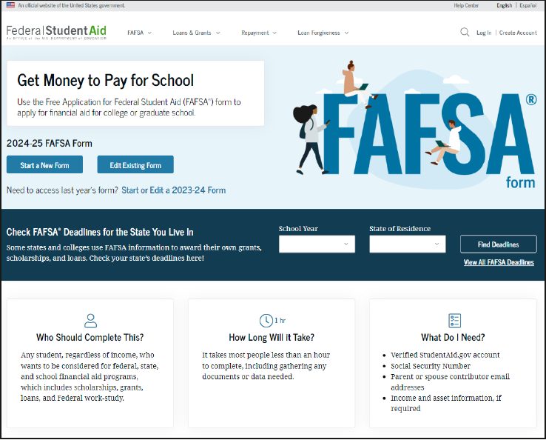
Go to StudentAid.gov
Click the “Create Account” Button

Slide 26
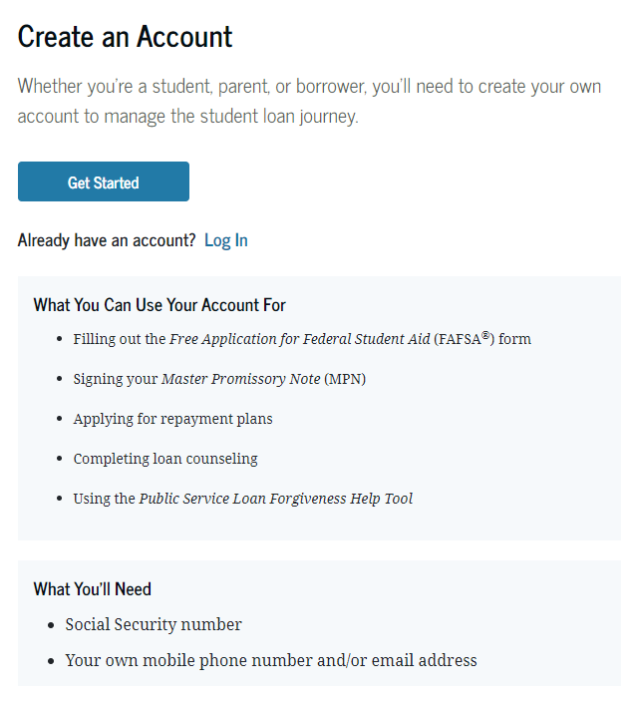
Create an Account
Click on “Get Started”

Slide 27
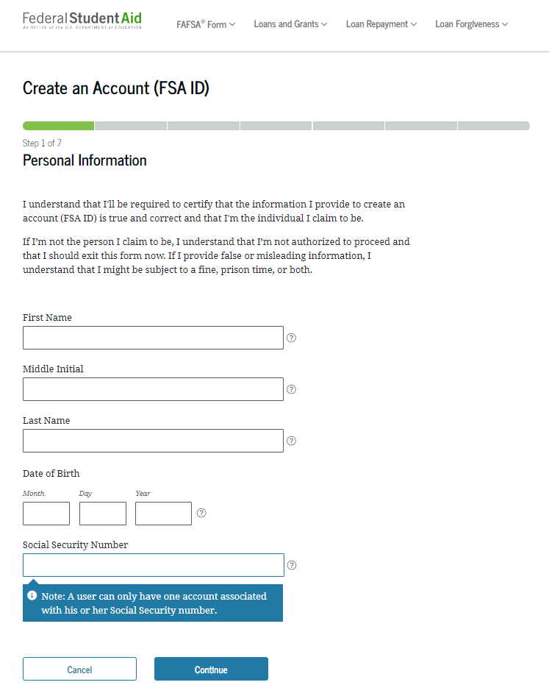
FSA ID

Slide 28
Important Tips for Creating the FSA ID
Email:
Optional but strongly
recommended
Each FSA ID must have a unique email address (student and
parent cannot use the same
email address).
You must have access to this
email account.
Username:
Suggest using email address or phone number. (Parents and students can use their phone number as a username.
Do not include personal info such
as date of birth or name.
If you see a message “Username taken, create a different username,” then someone has already used
that username.

Slide 29
FAFSA
Produced by the U.S. Department of Education
Collects family’s personal and financial information used to calculate student’s SAI (Student Aid Index)
Required to receive any Federal Aid including grants and loans (and some scholarships)
Available in English and Spanish

Slide 30
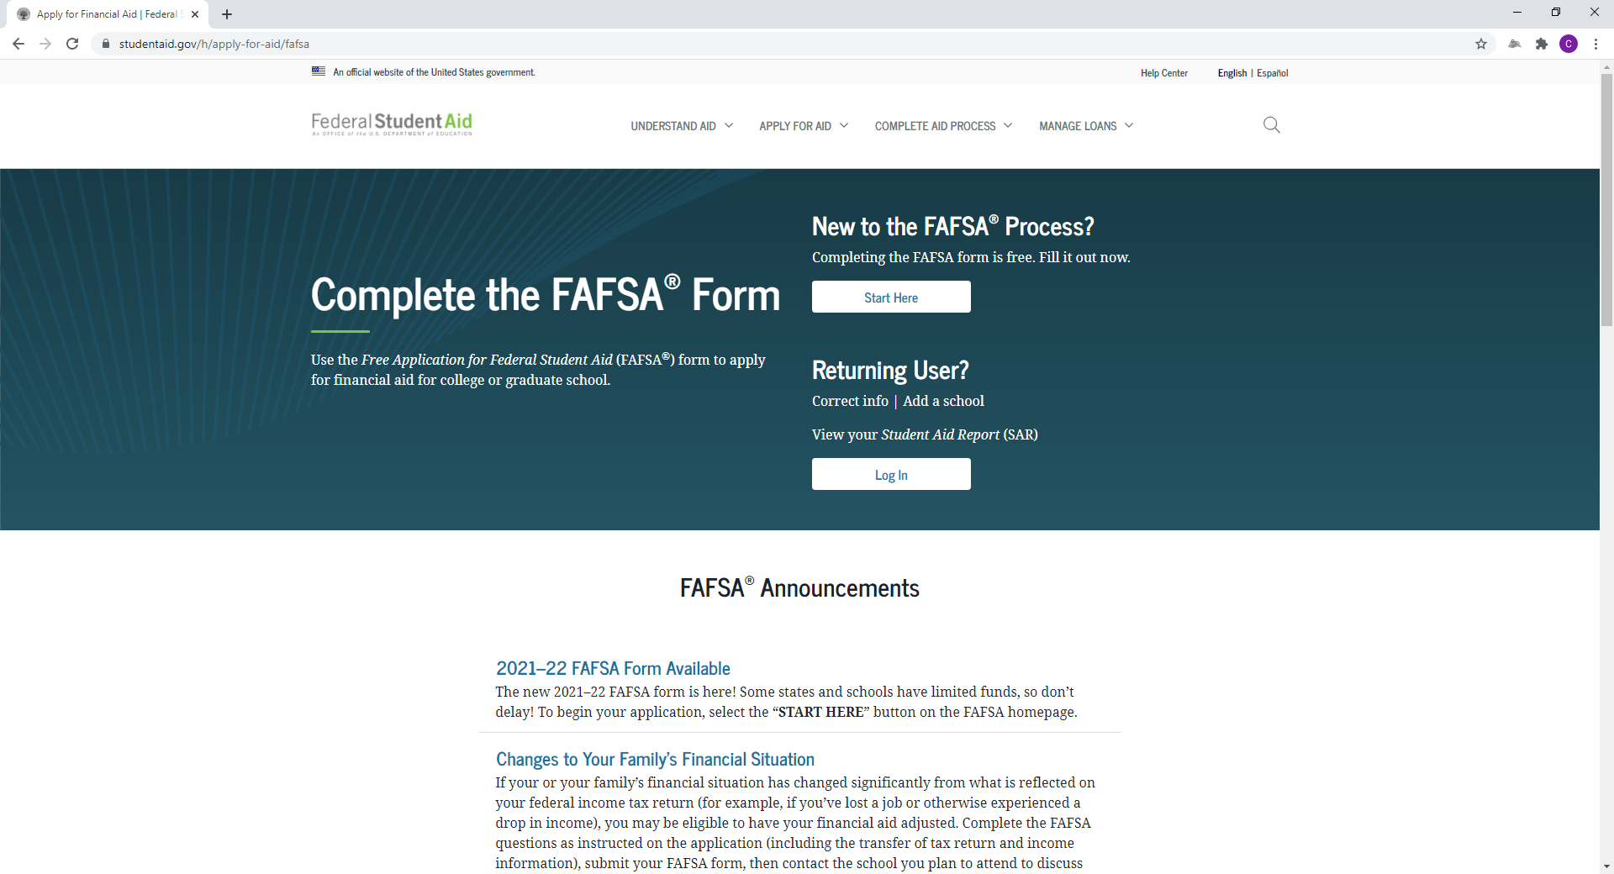
FAFSA on the WEB (FOTW)

Slide 31
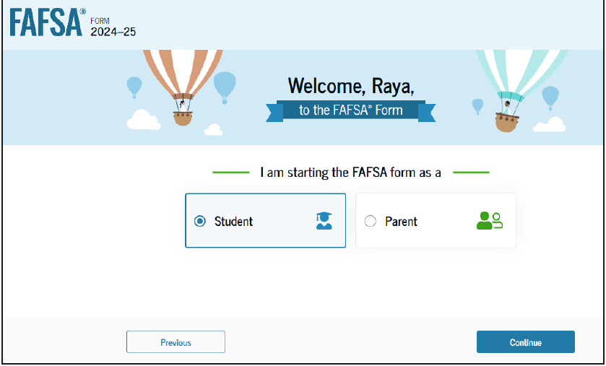
FAFSA on the WEB (FOTW)

Slide 32
FAFSA
Website: https://studentaid.gov
Available October 1 for the new academic year.
  December release for 2024-2025
[Your School Code]: {XXXXXX]
FAFSA on the Web Worksheet: Used as optional “pre-application” checklist

Slide 33
FAFSA Cont.
Benefits of filing electronically:
  Built-in edits to help prevent costly errors
  Simplification: Skip-logic allows student and/or parent to skip unnecessary questions
  Immediate submission of original application and any necessary corrections
  More detailed instructions than space allows on the pdf version of the FAFSA
  Help & Live Chat Assistance Options
  Ability to check application status on-line
  Simplified application process in subsequent years

Slide 34
FAFSA on the Web Worksheet
Helpful tool that includes questions that may be applicable to all students
Smart Logic means all students will not see same number and sets of questions on FOTW
Available in English & Spanish
Has four sections
  Student General Info
  Dependency Status Questions
  Student Information (Including financial)
  Parent Information (Including financial)

Slide 35
FAFSA Demo Site
FAFSA on the Web and FAA Access to CPS Online demonstration sites
To access site: https://fafsademo.test.ed.gov
Login credentials:
Username – eddemo
Password - fafsatest
https://fafsademo.test.ed.gov

Slide 36
IRS Data Retrieval Tool -> Direct Data Exchange
2024-2025: Income will come through a direct data sharing process between the IRS and Department of Education – FUTURE ACT & DIRECT DATA EXCHANGE FA-DDX
  All contributors on the FAFSA must provide consent to have information transferred directly from IRS using the DDX
Students completing a 2023-2024 Free Application for Federal Student Aid on the Web (FOTW) will be able to utilize IRS Data Retrieval Tool in October 2022
Data available in English and Spanish
Reduces documents requested by financial aid office

Slide 37
IRS Data Retrieval Tool
FOTW includes logic/questions to determine if applicant is eligible to use the IRS Data Retrieval Tool
Applicant’s response will take him or her to the IRS system or provide a message that the applicant should use their own financial figures to complete FOTW
“Unmarried and both parents living together” not eligible to use the IRS Data Retrieval
Same gender married couples using “married filing jointly” status can use IRS Data Retrieval

Slide 38
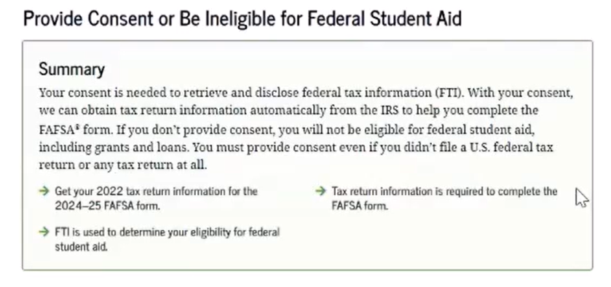
Direct Data Exchange

Slide 39
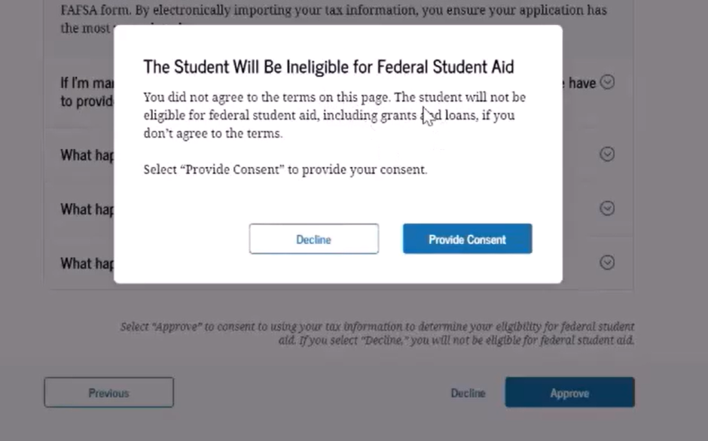
Direct Data Exchange
If a contributor declines consent, the following message will appear ->

Slide 40
Frequent FAFSA Errors
Parent and Student Social
Security Numbers
Divorced/remarried/unmarried
but living together parental information-which belongs
on the form
Income earned by parents/stepparents
Untaxed income
U.S. income taxes paid
Verifying FSA ID info
Household size
Real estate and investment
net worth
Not electronically signing the FAFSA or submitting the required paper signature page

Slide 41
AFTER The FAFSA
Presented by:
TASFAA EARLY AWARENESS COMMITTEE

Slide 42



FAFSA Processing Results
CPS
College
Student

Slide 43
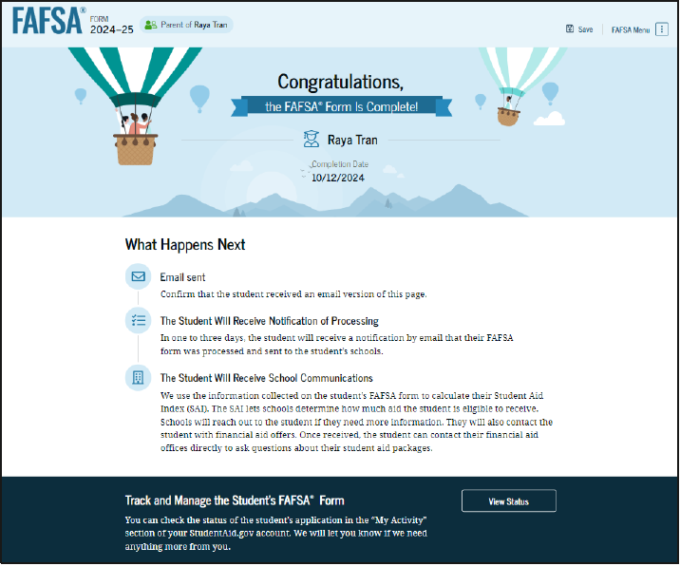
FAFSA Processing Results

Slide 44
FAFSA Processing Results

Slide 45
FAFSA Submission Summary Landing Page
The student receives a FAFSA Submission Summary for their processed FAFSA and any subsequent corrections that they submit. The FAFSA Submission Summary is broken into four tabs: Eligibility Overview, FAFSA Form Answers, School Information, and Next Steps. At the top, the student will see information about when their form was received and processed. They also have the option to print their FAFSA Submission Summary to keep for their records.

Slide 46
Eligibility Overview
Contains information about what federal aid the student may be eligible for
Amounts listed are estimates only and not guaranteed
Final determination will be provided by the school’s financial aid office

Slide 47
FAFSA Form Answers
Shows answers from student and contributors
If answers are incorrect, the student can choose to start a correction

Slide 48
School Information
Shows information about college(s) and/or career school(s) that the student has selected to send their FAFSA information
Students can compare graduation, retention, transfer, and default rates.

Slide 49
Next Steps
This tab shows comments that pertain to the FAFSA
Some comments may require the student to start a correction or send additional documentation to their school
Other comments may be informational and do not require any further action from the student

Slide 50
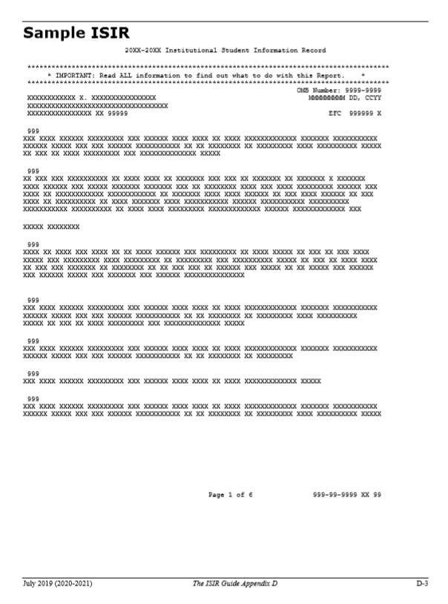
Institutional Student Information Record (ISIR)
FPS sends results to colleges listed on the FAFSA
College reviews ISIR and may request additional documentation

Slide 51
Determining Dependency Status
Unusual Circumstances
Dependency Status

Slide 52
Dependent Status
A student who is under 24 years of age
Unmarried
Not an orphan or ward of the state
Has no legal dependent(s)
Not a veteran of the U.S. Armed forces
Is not working on a graduate degree

Slide 53
Independent Status
If a student answers yes to any of the questions in Step One of the FAFSA, then they are considered independent and do not have to provide parent information.
The following circumstances can also make a student independent:
  Is emancipated
  Is in a legal guardianship
  Is homeless or at risk of being homeless
  Was in foster care any time AFTER turning 13 years old

Slide 54
Unacceptable Reasons for Independent Status
Parents do not claim student on taxes
Student lives on own and supports self
Parents do not want to help pay for college
Parents/Stepparents refuse to provide information for FAFSA

Slide 55
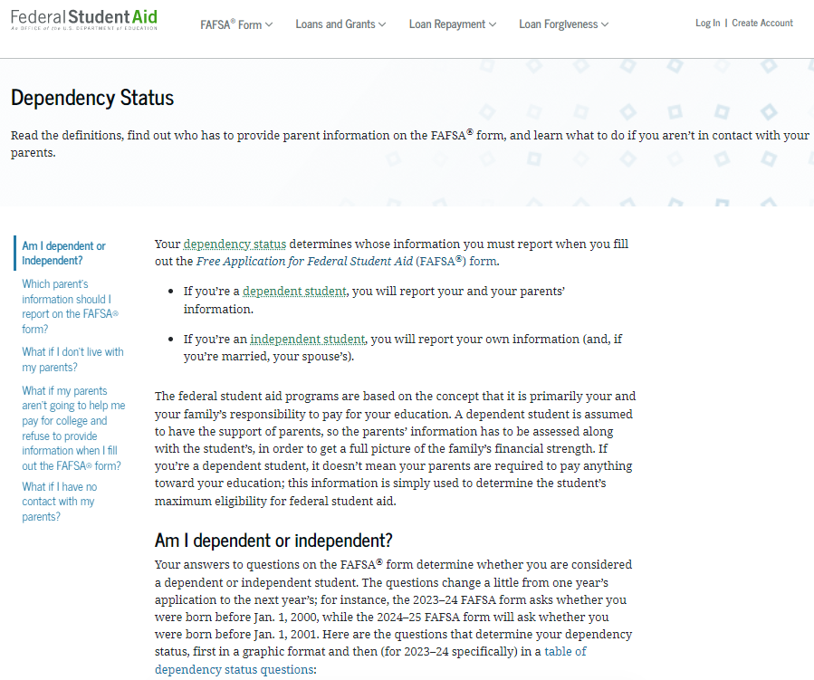
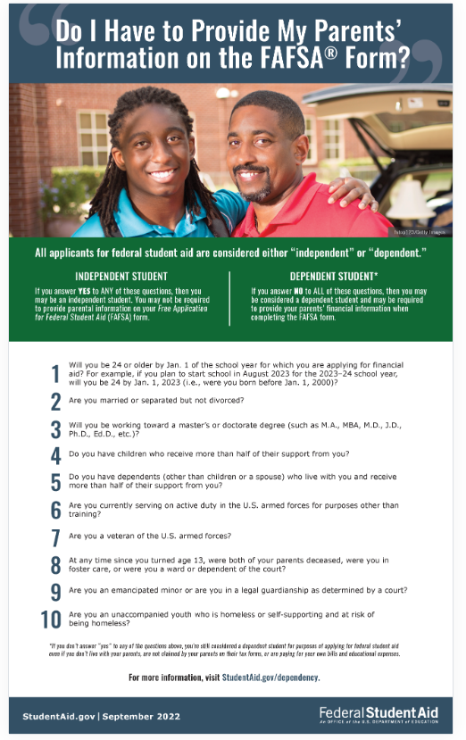
Dependency Status
https://studentaid.gov/help-center/answers/article/what-is-dependency-status

Slide 56
Dependency Overrides
Financial Aid Office has authority to change the filing status from dependent to independent
Student must present documentation of situation
Unusual circumstances include:
  Abuse at home
  Abandonment by parents
  Death of parents or encarceration

Slide 57
Dependency Overrides
Documentation from third party:
  Teacher
  Social worker
  Member of clergy
  Court system
  Law enforcement

Slide 58
Who is a parent?
Biological parents
Adoptive parents
Stepparents, if they are married to the student’s biological or adoptive parent

Slide 59
Who is not a parent?
Foster parents
Legal guardians who have not adopted the student
Any relatives (including grandparents) who have not adopted the student
Widowed stepparents who have not adopted the student

Slide 60
Determining Parent When Filing For Dependent Students
Are parents living together?
  Report information for both parents even if they were never married, are divorced, or are separated.
Are parents divorced or separated?
  Report only the income and assets of the parent who provides the greater portion of the student’s financial support
  If both parents claim an equal amount of support, report the parent with the greater amount of income or assets

Slide 61
Determining Parent When Filing For Dependent Students
Single parent who is not divorced or separated
  Report income and assets of single parent
Death of a parent
  If either of the parents has died, the surviving parent shall be considered a single parent, until that parent has remarried.
  If both parents have died, the student shall not report any parental income or assets.
Remarried parents
  Parent and parent’s spouse should be included

Slide 62
Determining and Reporting Number in Household
Parents cannot claim child in HH and claim child support paid
Do not consider who claimed child on tax return
“Other dependents”
Dependent student cannot claim sibling as dependent
The number in college question is no longer factored into the need equation

Slide 63
Income Changes
Child support received eliminated as income however it is added as an asset.
Cash support paid on student’s behalf is removed.

Slide 64
After the FAFSA
Reviewing the Student Aid Report (SAR)
Corrections
Verification
Professional judgment
Reviewing and comparing budgets and offer letters
Establishing a relationship with the financial aid office

Slide 65
Making Corrections
Corrections to FAFSA data may be made by:
  Using FAFSA on the Web (www.studentaid.gov) if student has an FSA ID
  Updating and mailing paper SAR
  Submitting documentation to school’s financial aid office
  Consistent messaging sent to use IRS Data Retrieval Tool if data is not transferred during initial submission
Make sure the student only corrects the information that was reported incorrectly when they filed the FAFSA.

Slide 66
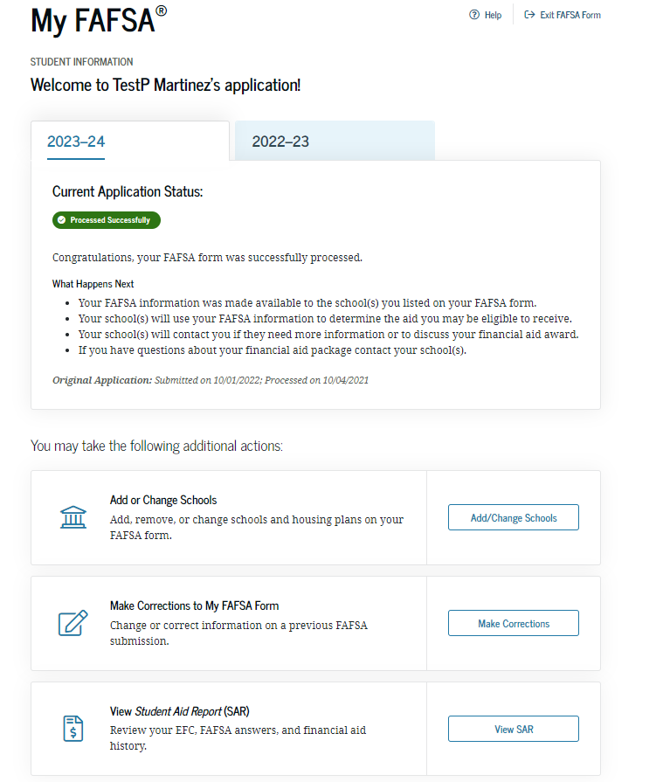
FAFSA Corrections

Slide 67
Verification
Process by which the U.S. Department of Education (ED) through the financial aid office confirms accuracy of the information provided by students and families on the FAFSA.
Students can be selected for verification by the Department of Education or their college
Items required to be verified will vary
  IRS Tax Return Transcript
  Letter of Non-Filing for (Student/Spouse if Independent or Parents only if Dependent)
Verification process is completed by the college

Slide 68
Professional Judgement
Purpose
  Financial Aid Officers have the authority to make some changes to the status of aid based on special circumstances.
Appropriate use
Process

Slide 69
Special Circumstances
Conditions exist that cannot be documented
with the FAFSA
Submit written explanation and documentation
to your college’s financial aid office
College will review and may request additional
information if necessary
Decisions are final and cannot be appealed to
the U.S. Department of Education

Slide 70

Examples
Secondary school tuition
Unusual uncovered medical/dental expenses
Extraordinary dependent care
Student cannot obtain parental information
Parent or spouse death
Loss of employment
Divorce

Slide 71
CSS Profile
The PROFILE is an online application that collects information used by certain colleges and scholarship programs to award institutional funds (NON-federal funds).
The PROFILE can be filed as early as October 1, but no later than 2 weeks before the earliest priority deadline of the schools you’re applying to.
Check your college’s/program’s information to determine if they require the PROFILE (can find a list on www.collegeboard.org).
You can print the Pre-Application Worksheet and Instructions to review with parents and fill out at home before applying online.
The fee for the initial application and one college or program is $25. Additional reports are $16.
Fee waivers* are granted automatically – based on the information entered on the PROFILE application – to students who are first-time college applicants and are from families with low incomes and assets. (Int’l students are not eligible for fee waivers).
*pays for up to 8 colleges/scholarship programs

Slide 72
Counseling Undocumented students
Presented by:
TASFAA EARLY AWARENESS COMMITTEE

Slide 73
Counseling Undocumented Students on Texas Financial Aid
Undocumented students definition
Student is allowed to pay in-state tuition
State financial aid and other state benefits
Other sources of financial aid
Requirements in the State of Texas
Note: State actions do not change the federal student assistance eligibility rules. Undocumented students remain ineligible for federal student assistance at this time.

Slide 74
What Does It Mean To Be Undocumented
Individual lacks the documents required for immigration or legal residence.
Individuals may have:
  Entered the country legally on a temporary basis and stayed after documents expired
  Entered without documents
  Been brought to the country by someone else

Slide 75
Currently 7 States have Provisions Allowing
State Financial Aid for Undocumented Students
California
Minnesota
New Mexico
Colorado
Texas
Washington
Oregon
Source: National Conference of State Legislatures, September 2019 http://www.ncsl.org/research/education/undocumented-student-tuition-overview

Slide 76
State of Texas TASFA/Senate Bill 1528
Certain categories of foreign-born and immigrant students in the State of Texas to qualify for residency under Texas Education Code Chapter 54, Section 54.052(a)(3). This state law allows such students to pay the resident tuition rate while attending public institutions of higher education in Texas and be classified as state residents for tuition purposes.
Graduated from a Texas high school or received GED in Texas

Slide 77
State of Texas TASFA/Senate Bill 1528
Lived in Texas for 36 months before receiving your high school diploma or GED
If there is a break between graduating from HS or receiving GED, must clearly establish a domicile in Texas for the 12 months preceding enrollment
Notarized Affidavit of Intent with the Admissions and Records office – declaring the student will apply for permanent residence as soon as it is available for them
Source: http://www.thecb.state.tx.us/reports/pdf/1528.pdf

Slide 78
TASFA: Texas Application for State Financial Aid
The Texas Application for State Financial Aid (TASFA) collects information to help determine eligibility for state (or institutional) financial aid programs administered by institutions of higher education in the state of Texas. Students classified as Texas Residents who are not eligible to apply for federal financial aid using the Free Application for Federal Student Aid (FAFSA) are encouraged to complete the TASFA. To review the FAFSA filing requirements, visit www.studentaid.gov or visit the financial aid office at the institution you plan to attend. Note: The federal application covers federal and state financial aid opportunities. If you meet the FAFSA filing requirements, then you should submit a completed FAFSA. You do not need to complete both the FAFSA and TASFA.
The Texas state priority deadline for many institutions of higher education is January 15 for the award year. It is recommended that applicants complete and submit this application and any other required documentation to the financial aid office on or before January 15.
**Due to the FAFSA being delayed, the Texas state priority deadline has been moved to March 15 for the 2024-25 academic year.
Note: Texas residency and final eligibility for financial aid can only be determined by the institution that you plan to attend.
The Texas Higher Education Coordinating Board (THECB) will not post the English and Spanish TASFA online for students until Oct. 1. At that time, both language versions will be available to students and their families on the College for All Texans and the Student Financial Aid Programs webpages. For questions, please contact Financial Aid Services at 1-844-792- 2640 or CONTACT US (select “Financial Aid Question” under Contact Reason).

Slide 79
TASFA
Requirements needed in addition to the TASFA application:
  Parent’s income tax return transcript, verification of non-filing letter, W2s, or statement of income
  Student’s income tax return transcript, verification of non-filing letter, W2s, or statement of income
  Males between the ages of 18 and 25 must register for selective service, either online (www.sss.gov) or by mail

Slide 80
FAQ
Does my parents’ citizenship status affect my eligibility for federal student aid?
No. Your parents’ citizenship status does not affect your eligibility for federal student aid. In fact, the FAFSA doesn’t even ask about your parents’ status.
For me to complete the FAFSA, do my parents need Social Security numbers?
No; since your parents’ citizenship does not affect your ability to complete the FAFSA, they do not need Social Security numbers. If your parents do not have Social Security numbers, you must enter 000-00-0000 when the FAFSA asks for parents’ Social Security numbers. If your parents do not have Social Security numbers, you must print out the signature page from the online FAFSA so that your parents can sign it and send it in.

Slide 81
Tracking High School Completion
Department of Education can help you track FAFSA Completions:
  https://studentaid.gov/data-center/student/application-volume/fafsa-completion-high-school

Slide 82
NEW! Estimating Your Federal Student Aid
Our Federal Student Aid Estimator provides an estimate of what federal student aid you may be eligible to receive.
Students, parents, and college access professionals who want to get an early estimate of what aid may be available to a student considering college or career school.
https://studentaid.gov/aid-estimator/

Slide 83

Questions and Discussion
Contact Info:
[Insert School Contact Information]

