Slide 1
Satisfactory Academic Progress (SAP)
Texas Association of Student Financial Aid Administrators

Slide 2
SAP
SAP is a progress required of a financial aid recipient to complete an educational program within a specified period.
SAP contains
Grade Based or its equivalent (qualitative)
Pace (quantitative) measure
Maximum Time Frame
Students must meet general student eligibility requirements for receipt of Title IV aid.
Schools have the responsibility of confirming students are making satisfactory academic progress before disbursing Title IV aid.
Texas Association of Student Financial Aid Administrators

Slide 3
SAP Elements
Academic standards for students receiving Title IV aid must be the same or stricter than the school’s standards for those not receiving federal aid in the same academic program.
Examples: Wiley E. Coyote College requires its students to maintain a 2.5 grade point average (GPA) to graduate, the Office of Financial Aid cannot evaluate the students’ satisfactory academic progress based upon a minimum 2.0 GPA. Financial aid recipients also must maintain a 2.5 GPA or higher
Texas Association of Student Financial Aid Administrators

Slide 4
Regulation
2022-2023 Student Aid Handbook , Volume 1- Student Eligibility
Applies to all Title IV (federal) financial aid
Most state and institutional aid
Some programs have academic progress requirements in addition to SAP (ex: TEXAS, TEACH)
Schools must have a reasonable policy for monitoring academic progress.
Reasonable means it measures both qualitative and quantitative components.
Policy must be at least as strict as academic policies for students in same program who are not receiving financial aid but can be more strict.
Texas Association of Student Financial Aid Administrators
Notes:
https://fsapartners.ed.gov/sites/default/files/2022-2023/2022-2023_Federal_Student_Aid_Handbook/_knowledge-center_fsa-handbook_2022-2023_vol1.pdf
Page 15 starts

Slide 5
And more Regulations
Must be the same for all students within the same category
Undergraduate, Graduate, Full Time, Half Time or Program of Study
Must evaluate SAP at least once per year at the end of a payment period of the school’s choice
Schools who choose to use a warning semester must evaluate SAP after every payment period (semester).
Policy must evaluate three main components
Qualitative component – GPA
Quantitative component – pace/completion rate
Maximum timeframe
Texas Association of Student Financial Aid Administrators

Slide 6
Main SAP Components
Quantitative
Qualitative
Includes pace of progress through program (% of program completed)
Grade based
Can be GPA or appropriate alternative measure of academic achievement
Maximum timeframe
Texas Association of Student Financial Aid Administrators

Slide 7
Maximum Timeframe
Undergraduate students lose aid eligibility if they accumulate more hours than the equivalent of 150% of their published program hours
So:
Program=120 credit hours
150% of program=180 credit hours
If a student is trying to finish their degree but has earned 180 or more, they will not be able to receive financial aid
Graduate students:
Maximum time frame is defined by the school, based on the length of the program

Slide 8
Warning Semester
Can be used by schools who measure SAP at the end of every payment period
Allows students who are not meeting SAP to receive financial aid for one additional semester/payment period
Intent is to give students the chance to reestablish their academic standing and meet the SAP requirements
It is possible for a student to receive more than one warning period, but not for two semesters/payment periods in a row.
Texas Association of Student Financial Aid Administrators

Slide 9
What if one semester is NOT enough???
Texas Association of Student Financial Aid Administrators

Slide 10
Student Can File SAP Appeal
SAP Appeal
Is the process by which a student who is not meeting school’s SAP policy petitions for reconsideration of eligibility for Aid
In order to grant the appeal, the student must be mathematically able to meet SAP
Plan must identify a point in time, in the future, when the student will regain SAP or will successfully complete the academic program (one or more semesters)
Initial and subsequent appeals are possible
Academic Plan
Schools set their own procedures for creating academic plans
Schools also determine what documentation a student must provide
Resulting plan lays out exactly what the student must achieve for aid eligibility
Texas Association of Student Financial Aid Administrators

Slide 11
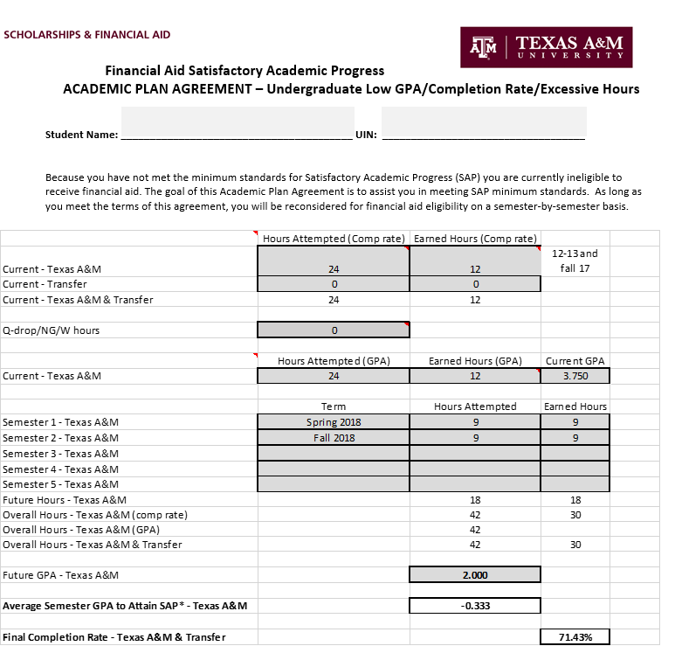
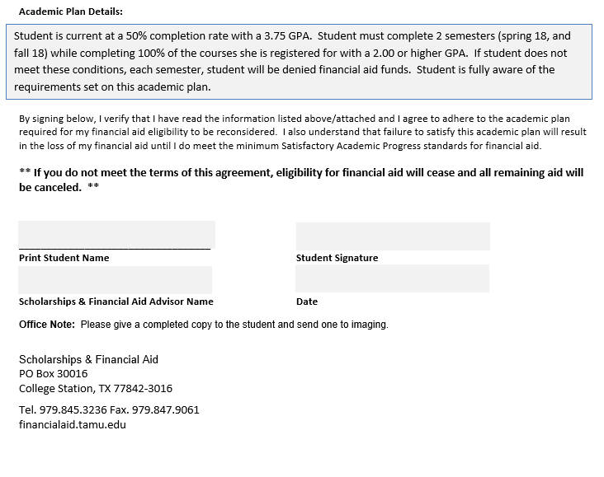
Example of An Academic Plan
Texas Association of Student Financial Aid Administrators

Slide 12
Once on an aid plan
This is after a WARN semester, if not evaluating sap annually
PROBATION
To be placed on probation , a student must:
Have appeal approved by the school
A student on Probation may only receive TITLE IV funds for ONE payment period
A student on probation may not receive title IV funds for the subsequent semesters/periods unless:
Student is now meeting SAP
or
School determines student met requirements specified on the academic plan and student has remining semesters/periods on the academic plan
SAP must be checked at the end of the probabtionary semester/period
(even if SAP is checked annually by your school)
Texas Association of Student Financial Aid Administrators

Slide 13
What if you do not meet the academic plan set???
The student does not meet the terms of the academic plan and remains in a bad SAP status?
Student can only regain eligibility by improving their academic performance enough that they are once again meeting overall SAP requirements
Texas Association of Student Financial Aid Administrators

Slide 14
Things to Do Now
Read your SAP Policy
Does your office allow appeals?
Do you know what your academic plan looks like?
Who processes appeals in your office?
Do they work directly with the students?
How often does your school evaluate SAP?
End of Each Term
Annually
No WARN term can be given
Texas Association of Student Financial Aid Administrators

Slide 15
Quiz
What is the definition of SAP?
Texas Association of Student Financial Aid Administrators
Notes:
The progress required of a financial aid recipient in academic studies to successfully complete the educational program within a specified period of time. SAP requirements include a maximum timeframe, a grade or its equivalent (qualitative), and for term-based credit-hour programs a pace (quantitative) measure.

Slide 16
Quiz
The SAP standards for students receiving federal financial aid must be less strict than the standards for students not receiving federal financial aid?
TRUE or FALSE
Notes:
False

Slide 17
Quiz
Federal regulations require that SAP standards be applied consistently to:
All Title IV programs and Title IV recipients within identifiable categories of students
Recipients of subsidized FSA program with identifiable categories of students
Undergraduate, full-time students and part time students only
Subsidized FSA, institutional scholarship, and private loan recipients within identifiable categories of students
Notes:
A : All Title IV programs and Title IV recipients within identifiable categories of students

Slide 18
Quiz
Maximum timeframe for a graduate program is:
150% of the published program length expressed in attempted credit hours or calendar time
Defined by the school based on the length of the program
180 credit hours or 1200 clock hours
Defined by the U.S. Department of Education as 120 credits
Notes:
B: defined by the school based on the length of the program

Slide 19
Quiz
Pace is?
A quantitative standard
A qualitative standard
The same as maximum timeframe
Not a component of SAP
Texas Association of Student Financial Aid Administrators
Notes:
A: qualitative standard

Slide 20
Quick Quiz
The maximum timeframe for an undergraduate program offered in credit hours can be no longer than ___________________of the published length of the program, expressed in attempted credit hours or calendar time.
Texas Association of Student Financial Aid Administrators
Notes:
150 percent

Slide 21
Quiz
At what point in time must a student meet SAP standards after being placed on financial aid probation?
Before progressing to a new grade level
At the end of the next semester/payment period
At the end of the current academic year
Before financial approval is given for the students SAP appeal
Notes:
B at the end of the next semester/payment period

Slide 22
Quiz
Financial Aid probation status can be granted only after the student has:
Earned hours with a 3.0 or better for one semester
Received a request from faculty advisor to have aid eligibility reinstated based on current academic performance
Successfully appeal an adverse SAP evaluation
Enrolled for one semester at her own expense and eared a credit in 70% of the hours attempted
Notes:
C successfully appeal an adverse SAP evalation

Slide 23
Questions!!!
Texas Association of Student Financial Aid Administrators

Slide 24
SAP Definitions
Appeal—A process by which a student who is not meeting SAP standards petitions the school for reconsideration of his eligibility for Title IV funds. Financial aid
Probation—A status a school assigns to a student who is failing to make satisfactory academic progress and who successfully appeals. Eligibility for aid may be reinstated for one payment period.
Financial aid warning—A status a school assigns to a student who is failing to make satisfactory academic progress. The school reinstates eligibility for aid for one payment period and may do so without a student appeal. This status may only be used by schools that check SAP at the end of each payment period and only for students who were making SAP in the prior payment period for which they were enrolled or who were in the first payment period of their program.

Slide 25
Sap Definitions
Maximum timeframe:
For an undergraduate program measured in credit hours, a period no longer than 150 percent of the published length of the program, as measured in credit hours, or expressed in calendar time. If your school chooses to use calendar time to measure maximum timeframe, you evaluate a student’s pace by determining the number of hours that the student should have completed at the evaluation point in order to complete the program within the maximum timeframe. Measuring credits completed over calendar time may be considered a stricter method of evaluation, as it holds a student to the same pace regardless of the student’s enrollment status in any given payment period. Note that evaluating SAP progress via calendar time for credit hour programs is optional; you may still evaluate progress for these programs by measuring credit hours.
For an undergraduate program measured in clock hours, a period no longer than 150 percent of the published length of the program as measured by the cumulative number of clock hours the student is required to complete and expressed in calendar time. (Note that a student in a clock hour program cannot receive aid for hours beyond those in the program; the maximum timeframe applies to the amount of calendar time the student takes to complete those hours.)
For a graduate program, a period the school defines that is based on the length of the program. Credit hour graduate programs may also measure maximum timeframes either in credit hours or calendar time.

