Slide 1
Return to Title IV (R2T4)
Sarah Gordon
Texas A&M University
Sarah.Gordon@tamu.edu
Texas Association of Student Financial Aid Administrators

Slide 2
Quick Poll to Start
Who has heard of or is familiar with Return to Title IV?
Does (or will) anyone have this as one of their primary job responsibilities?
Does anyone’s school use clock hours (rather than credit hours)?
Show of hands:
School is attendance taking?
School is not attendance taking?
Texas Association of Student Financial Aid Administrators

Slide 3
R2T4 Terminology
Calc
LDA
result of the information collection and the completion of the R2T4 worksheet
last date of attendance
Date of Determination
COD
date on which the school was notified that the student was withdrawn
Common Origination and Disbursement website from the US Dept of Education

Slide 4
R2T4 Basics
Texas Association of Student Financial Aid Administrators

Slide 5
Basic Principles
Title IV funds are awarded to a student with the assumption that the student will attend school for the entire period for which the assistance is awarded
Texas Association of Student Financial Aid Administrators

Slide 6
Basic Principles
When a student ceases attendance prior to the planned ending date, the student may not be eligible for the full amount of Title IV fund the student was scheduled to receive
Texas Association of Student Financial Aid Administrators

Slide 7
Basic Principles
Student earns aid in proportion to the percentage of the term they completed prior to their withdrawal
The farther into the term the student goes, the more aid they have earned
Once they have completed 60.01% of the total number of days they were scheduled to complete, they are considered to have earned all of their aid
Texas Association of Student Financial Aid Administrators

Slide 8
Basic Principles
If a student was disbursed more aid than they earned, the school and/or the student must return the funds to the Department of Education
If the student earned more than was disbursed, then the school may be required to offer the student a post-withdrawal disbursement
Texas Association of Student Financial Aid Administrators

Slide 9
Lots of Regulation, Lots of Flexibility
Any school that offers Title IV aid must adhere to the Return to Title IV regulations and do required returns
However, the regulations are written to allow schools to implement them in a way that makes sense for their programs, calendars, disbursement schedules, etc.
The result of this is that no two schools use exactly the same procedures to get to the same end product
Texas Association of Student Financial Aid Administrators

Slide 10
Impact of R2T4 on Financial Aid Offices
Very heavily audited area of financial aid
Very little automation of the process is possible, due to number of variables
Accuracy and documentation are critical!
Texas Association of Student Financial Aid Administrators

Slide 11
Basic Steps to Process R2T4
Identify Students
Collect Info
Perform Calc
Adjust Aid
Notify Student
Texas Association of Student Financial Aid Administrators

Slide 12
Identifying Students
Multiple types of withdrawals
Official-student follows university procedure for separating from the school prior to the end of a term
Unofficial-student stops attending/participating during the term, so does not complete the courses on their schedule
Circumstances beyond the student’s control - i.e., when a student passes away
Because there are multiple types, your school probably has multiple channels they use to identify withdrawn students that need an R2T4 calc
Texas Association of Student Financial Aid Administrators

Slide 13
Collecting Information
Before a calc can be completed, we must know the:
Withdrawal date
Scheduled start and end dates
Scheduled breaks, if any
Attendance requirements (if any) for the program
Type of withdrawal (official, unofficial, etc)
Date of determination that the std withdrew
Amts of institutional charges (tuition & fees, room, board)
How much aid was disbursed from each Title IV program

Slide 14
What Does NOT Affect the Calc:
The reason for the withdrawal
There are almost no exceptions to the requirement to calc (beyond current COVID flexibilities
Institutional refund policies
Even if a student receives a full refund from the school, we are still required to return Title IV funds per the result of the calc
Retroactive action
If a student withdraws from a previous term, a calc is still required in most cases
Academic remedies
Administrative decisions can be made that result in no-record drops or drop deletes so that the student’s academic record is not adversely affected

Slide 15
Attendance and R2T4
Attendance Required
Attendance Not Required
Withdrawal date for student is always going to be the last date of attendance
More strict definitions of withdrawal date and date of determination since records are available
Even though attendance taking is not required, some step must be taken during each payment period/period of enrollment to ensure that eligibility has been established
Each school can decide what mechanism to use to do this

Slide 16
The Role of Attendance Confirmation
Extent of confirmation needed depends on aid type:
For loans, student must have begun attendance in at least one course that counts
For Pell, TEACH, or IASG, withdrawn student must have begun attendance in all of the courses for which Pell paid
If they have not begun in all courses, then Pell/TEACH/IASG must be adjusted down prior to the completion of the calculation

Slide 17
Modules and R2T4
Definition of module from the regulations:
“A program is ‘‘offered in modules’’ if the program:
Uses a standard-term or nonstandard-term academic calendar
Is not a subscription-based program,
A course or courses in the program do not span the entire length of the payment period or period of enrollment.”
Texas Association of Student Financial Aid Administrators

Slide 18
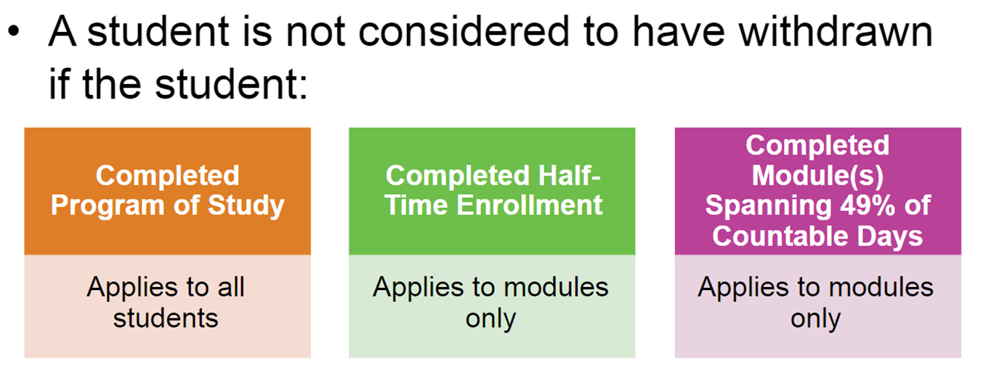
Exemptions
(Graduated)
Texas Association of Student Financial Aid Administrators

Slide 19
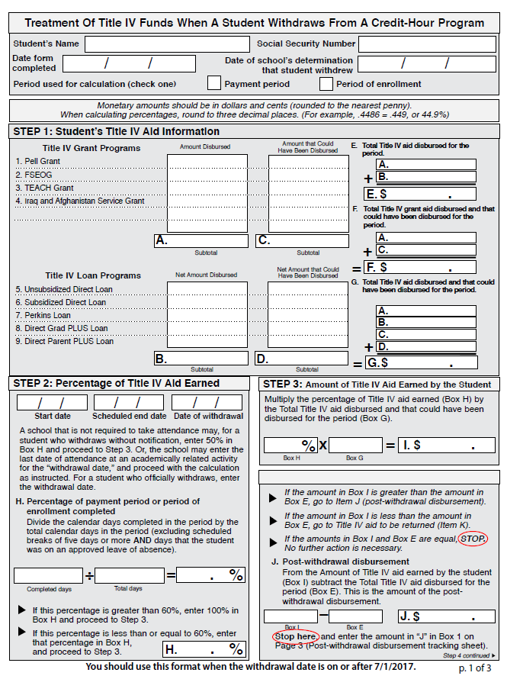
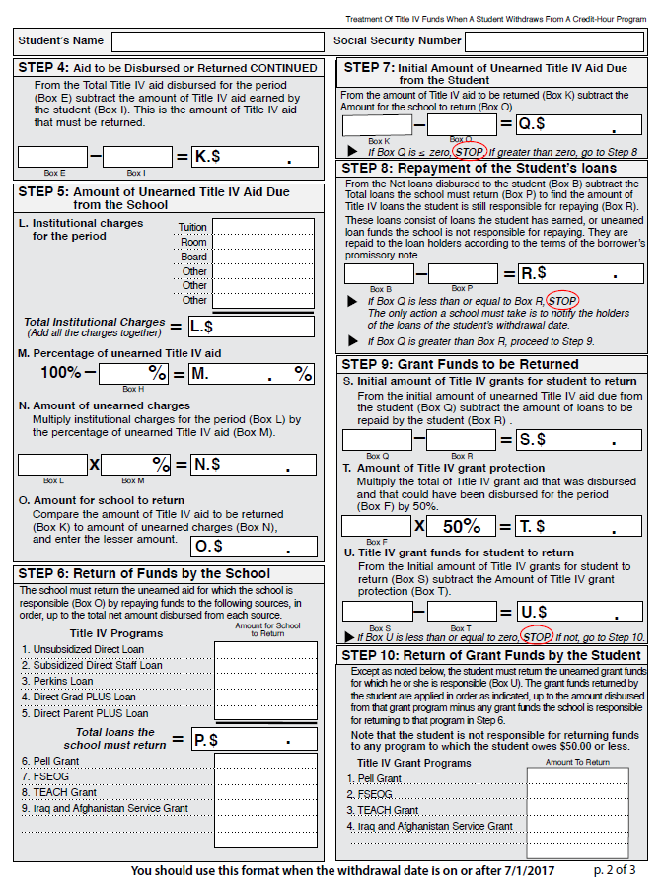
The R2T4 Worksheet

Slide 20
Performing the Calc
Texas Association of Student Financial Aid Administrators

Slide 21
Options for Processing R2T4
Each school is allowed to choose how they process R2T4 calculations
Some develop their own tools, some choose to use features built into their student information system
Some choose to use the tool in COD
Texas Association of Student Financial Aid Administrators

Slide 22
COD Tool
COD tool simplifies the process of filling out the form itself (similar to using an online tax filing service for completing annual tax returns)
Calendars can be easily tracked and reused
Use of tool is not required by any regulation
Texas Association of Student Financial Aid Administrators

Slide 23
Practice
Texas Association of Student Financial Aid Administrators

Slide 24
Hertfordshire College
General Information
Spring 2021 Term Dates
4-year college
Credit hours
AY length: 30 weeks
2 15-week semesters (standard terms)
Not required to take attendance
Start date: 1/19/21
End date: 5/7/21
Spring break (all in-person): 3/13/21-3/21/21 (9 days)
Spring break (with web-based courses): 3/15/21-3/19/21 (5 days)

Slide 25
Example #1: Lydia Wickham
Enrollment
Withdrawal
Enrolled in FT hours
Began attendance in 3/4T hours
All in-person courses
Officially withdrew on 2/15/21
Financial Aid Disbursed
Institutional Charges
Scholarship: $1000
Pell: $3173
Subsidized loan: $2721
Unsubsidized loan: $990
Tuition & Fees: $6491

Slide 26
Example #2: Lizzie Bennet
Enrollment
Withdrawal
Enrolled in FT hours
Some in-person, some web courses
Officially withdrew on 3/28/21
Financial Aid Disbursed
Institutional Charges
Pell: $3173
Subsidized loan: $2721
Unsubsidized loan: $990
Parent PLUS: $4562
Tuition & Fees: $6491
Housing: $3260
Food: $1520

Slide 27
Example #3: Jane Bennet
Enrollment
Withdrawal
Enrolled in FT hours
All in-person courses
Officially withdrew on 3/28/21
Institutional Charges
Financial Aid Disbursed
Tuition & Fees: $6491
Housing: $3260
Food: $1520
Pell: $3173
Subsidized loan: $2721
Unsubsidized loan: $990

Slide 28
Aid Adjustments and Student Notification
Texas Association of Student Financial Aid Administrators

Slide 29
Aid Adjustments
All aid adjustments must be done according to the calc worksheet and in the regulatory timeframe
Refer to your school’s policies and procedures to understand
Who does the aid adjustments
Who ensures that the adjustments were recorded on the student’s record in COD

Slide 30
Student Notification
The regulations require that students and/or their parents be notified of any obligations to repay within a certain timeframe after their withdrawal
Refer to your school’s policies and procedures to understand who is responsible for reporting R2T4 related data to :
The student
The parent (for parent PLUS loans)
NSLDS

Slide 31
Resources
Texas Association of Student Financial Aid Administrators

Slide 32
Regulatory Documentation
Code of Federal Regulations
FSA Handbook
Volume 5
43 CFR 668.22
Program Integrity Q&As
FSA Partner Connect
Knowledge Center
Return of Title IV Funds
Texas Association of Student Financial Aid Administrators

Slide 33
Other Training and Resources
FSA Training Center
Learning Track-Student Withdrawals
https://fsatraining.ed.gov/course/index.php?categoryid=114
FSA Training Conference (Nov 28-Dec 1, 2023)
100% remote
Free to attend
NASFAA Resources
AskRegs
Self-Study Guide
Credential Test

Slide 34
Thank you!
Texas Association of Student Financial Aid Administrators

