Slide 1
Pell and Campus Based Aid
Andreina Villarreal
San Jacinto College
Texas Association of Student Financial Aid Administrators

Slide 2
Types of Federal Grants
Pell Grant
Federal Supplemental Educational Opportunity Grant (FSEOG)
TEACH Grant
Texas Association of Student Financial Aid Administrators

Slide 3
General Eligibility
Valid FAFSA with requirements fulfilled
Meet general student eligibility for Title IV aid
US Citizen or Eligible Non-Citizen
Not in default on federal debt
Aggregate limits not exceeded
Not owe Title IV refund
High School graduate or equivalent
Enrolled in an eligible program at an eligible institution
Texas Association of Student Financial Aid Administrators

Slide 4
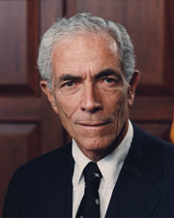
Pell History
Claiborne Pell
November 22, 1918 – January 1, 2009
United States Senator of Rhode Island
Served 6 terms from 1961-1997
Pell Grant was first awarded
Academic Year 1973-1974
Texas Association of Student Financial Aid Administrators

Slide 5
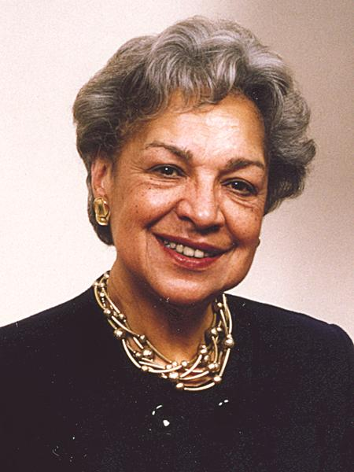
Pell History
Lois Rice “Mother of the Pell Grant”
February 28, 1933 – January 4, 2017
American corporate executive, scholar and education policy expert
National Vice President of the College Board
1973 until 1981
Texas Association of Student Financial Aid Administrators

Slide 6
Pell Grant Basics
Considered the foundation of all Federal Student Aid Programs
Pell Grant is always packaged first
Entitlement Fund
Grant = FREE Money = Does not have to be repaid
Need Based Aid = Not all students qualify
Amounts range from $769 - $6895 (22-23)
Maximum Eligible EFC is 6202
Amount is determined by
Expected Family Contribution (EFC)
Cost of Attendance (COA)
Enrollment Status
Texas Association of Student Financial Aid Administrators

Slide 7
Pop Quiz
Pell Grant is determined by what 3 factors?
Estimated Family Contribution (EFC)
Cost of Attendance (COA)
Enrollment Status
Texas Association of Student Financial Aid Administrators

Slide 8
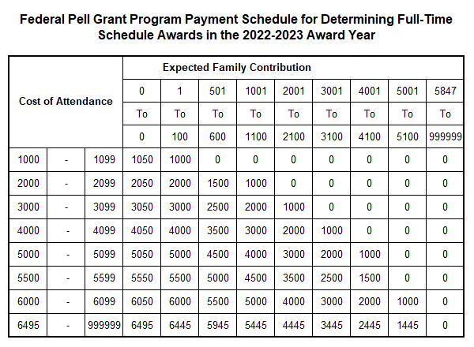
Pell Grant Definitions
Scheduled Award: The maximum Pell Grant a student can receive if enrolled full-time for a full academic year.
Annual Award: Award based on the student’s true enrollment status (Full time, ¾ time, ½ time, less than half time)
Texas Association of Student Financial Aid Administrators

Slide 9
Pell Grant Student Eligibility
Must be an undergraduate
Must not have previously earned first Bachelors/Professional degree
Must have a Pell eligible EFC – award amount linked to EFC ranges
Eligible EFC is from 0 - 6202
Must have eligibility remaining in aggregate lifetime limit
Must be enrolled in hours counting toward the degree
Must have eligible enrollment and EFC combination
Texas Association of Student Financial Aid Administrators

Slide 10
Calculating Pell Award
Formula 1-Credit hour program with terms -At least 30 weeks of instructional time, no overlap
Formula 2-Credit hour program with terms -Less than 30 weeks of instructional time, no overlap
Formula 3-Credit hour program with non- standard terms -Terms may overlap, more or less than 30 weeks
Formula 4-Clock Hour and Credit hour program without terms
Formula 5-Correspondence Study
SEE VOLUME 3 CHAPTER 3 of the FSA Handbook
Texas Association of Student Financial Aid Administrators

Slide 11
Student Example – Basic Calculation
For this example, the school uses Formula 1
Jake is enrolled in 13 hours each semester
The full-time cost of attendance is 30,000
Jake’s program contains a fall and spring semester
Jake’s EFC is 20
Texas Association of Student Financial Aid Administrators

Slide 12
Example – Formula 1 Summary
Standard term, credit hour programs
30 weeks of instructional time
Full time status is at least 12 credit hours
Academic calendar includes
2 semesters, trimesters or, 3 quarters
No overlapping terms
Texas Association of Student Financial Aid Administrators

Slide 13
Example – Formula 1 Pell Calc
Step 1: Determine Enrollment Status
Full time = 12 or more credit hours
Three quarter time = 9-11 credit hours
Half time = 6-8 credit hours
Less than half time = 5 or fewer credit hours
What is Jake’s enrollment status?
Full Time
Texas Association of Student Financial Aid Administrators

Slide 14
Example – Formula 1 Pell Calc
Step 2: Calculate Pell Grant Cost of Attendance (COA)
What is Jake’s COA?
30,000
Texas Association of Student Financial Aid Administrators

Slide 15
Example – Formula 1 Pell Calc
Step 3: Determine the Scheduled Award and Annual Award
Look up students cost of attendance and EFC on the payment schedule.
Payment schedule can be found here:
https://fsapartners.ed.gov/sites/default/files/2022-01/20222023PellPaymentSchedules.pdf
Texas Association of Student Financial Aid Administrators

Slide 16
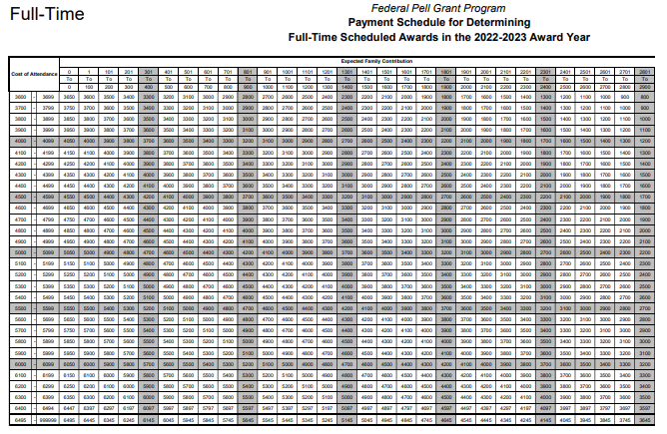
Pell Payment Schedule 2022-2023
Texas Association of Student Financial Aid Administrators

Slide 17
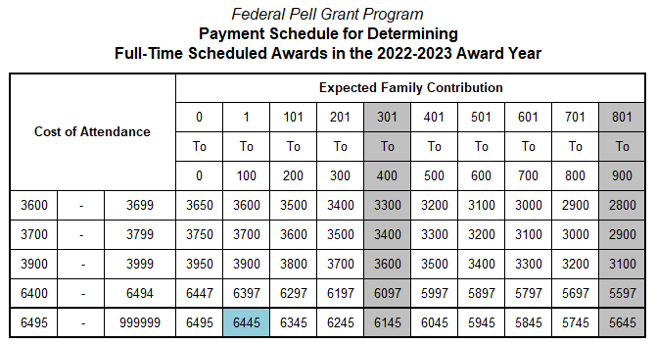
Pell Payment Schedule
What is Jake’s Annual Award?
$6445
Texas Association of Student Financial Aid Administrators

Slide 18
Example – Formula 1 Pell Calc
Step 4: Determine Payment Periods
Standard term programs use the term as the payment period
Semesters
Trimesters
Quarters
How many payment periods are there?
How many pay periods does Jake have?
2
Texas Association of Student Financial Aid Administrators

Slide 19
Example – Formula 1 Pell Calc
Step 5: Calculate Payment Per Payment Period
Annual Award
# of payment periods
in academic year
=
Payment Per Period (semester/trimester/quarter)
Texas Association of Student Financial Aid Administrators

Slide 20
Example – Formula 1 Pell Calc
Step 5: Calculate Payment Per Payment Period
$6445
2
=
$3222.5
Alternate rounding up/down
($3223 fall, $3222 spring)
Texas Association of Student Financial Aid Administrators

Slide 21
Pell Initial Calculation
First time Pell calculation made on or after the date the school has received an ISIR with an official EFC
Use current enrollment status
Use current EFC
Document date of initial calculation
Texas Association of Student Financial Aid Administrators

Slide 22
Pell Recalculations
Required Recalculations
Enrollment status changes between terms
Student did not begin attendance
EFC changes
Institutional Options
May have Pell recalculation date such as census that freezes enrollment status
May calculated for all enrollment status changes during term
Texas Association of Student Financial Aid Administrators

Slide 23
Pop Quiz
When are recalculations required?
Enrollment status changes between terms
Student did not begin attendance
EFC changes
Texas Association of Student Financial Aid Administrators

Slide 24
Pell Lifetime Eligibility Used - LEU
Consolidated Appropriations Act, 2012 –
Established Pell Lifetime Eligibility Used (LEU)
Lifetime limit of Pell is 12 full time semesters or its equivalent
Effective with the 2012-2013 award year
Applies to all students
Includes all years of the Pell/Basic Grant Program
Records date back to the 1973-1974 Award Year
Texas Association of Student Financial Aid Administrators

Slide 25
Pell LEU Calculation
12 semesters of full time Pell = 600% of Pell eligibility
Previously used percentage included on ISIR
C-flags will identify students that are close to 600%
Calculate remaining percentage by visiting COD or NSLDS
Formula for remaining percentage is:
600% - previous eligibility used% = remaining eligibility%
Texas Association of Student Financial Aid Administrators

Slide 26
Pell LEU Results
Once LEU reaches 600%, student is no longer eligible for Pell
If LEU is more than 500% but less than 600%, partial eligibility for the current award year may be awarded
Pell received prior to Consolidated Appropriations Act also counts in calculation
Texas Association of Student Financial Aid Administrators

Slide 27
Pop Quiz
Can COD or NSLDS show a student over 600%?
Yes
Texas Association of Student Financial Aid Administrators

Slide 28
Concurrent Enrollment
Student may ONLY receive Pell at ONE Institution during any given semester/payment period
If concurrent enrollment appears to exist, schools are notified by COD -PGMR files
Student has a choice of which school to receive Pell from, typically from degree seeking/home institution
One school MUST back out its payment to resolve the issue
Texas Association of Student Financial Aid Administrators

Slide 29
Potential Overaward Process - POP
Student may receive only one Scheduled Award in the award year – 100% maximum
School(s) notified when COD system receives disbursement information that a student has received more than 100% of Scheduled award
Exception – student may receive 150% of Pell if additional eligibility indicator is checked in COD and student is receiving summer Pell
School(s) is notified when COD receives disbursement information showing greater than 150% of Scheduled award paid
Schools have 30 days to resolve POP
Texas Association of Student Financial Aid Administrators

Slide 30
Year-Round Pell (YRP)
Per the Consolidated Appropriations Act of 2017, a student may receive Pell Grant funds up to 150% of the Scheduled Award in an award year
The first 100% is initial Pell award
Final 50% is considered the additional Pell award (YRP)
Effective for the 2017-2018 award year
Texas Association of Student Financial Aid Administrators

Slide 31
Pop Quiz
A student may receive Federal Pell Grant that exceeds 150 percent of the Scheduled Award
True
False
Texas Association of Student Financial Aid Administrators

Slide 32
Year-Round Pell (YRP)
Enrollment status and Pell percentage per semester
Full time = 50% of Scheduled award
Three quarter time = 37.5% of Scheduled award
Half time = 25% of Scheduled award
Less than half time = 12.5% of Schedule award
The student must be enrolled at least half time during a semester they are receiving over 100% of the Scheduled award
Texas Association of Student Financial Aid Administrators

Slide 33
YRP – Crossover Pell
Summer is a crossover payment period because the semester includes dates from two different aid years
Institutions have choice of aid year for summer Pell
Pay out of current aid year if eligibility in 150% remains
Pay out of future aid year with summer as a header
May make decision on a student-by-student basis
Must have valid ISIRs from both years to award Pell from future aid year
Texas Association of Student Financial Aid Administrators

Slide 34
Year-Round Pell Examples
Eligible combinations of enrollment
Semester | Enrollment | Semester Pell % | Running Total %
Fall | Full Time | 50% | 50%
Spring | Full Time | 50% | 100%
Summer | Full Time | 50% | 150%
Semester | Enrollment | Semester Pell % | Running Total %
Fall | ¾ Time | 37.5% | 37.5%
Spring | Full Time | 50% | 87.5%
Summer | Less than HT | 12.5% | 100%
Texas Association of Student Financial Aid Administrators

Slide 35
Year-Round Pell Examples
Ineligible combinations of enrollment
Semester | Enrollment | Semester Pell % | Running Total %
Fall | Full Time | 50% | 50%
Spring | Full Time | 50% | 100%
Summer | Less than HT | No Eligibility | 100%
Semester | Enrollment | Semester Pell % | Running Total %
Summer (header) | Full Time | 50% | 50%
Fall | Full Time | 50% | 100%
Spring | Less than HT | No Eligibility | 100%
Texas Association of Student Financial Aid Administrators

Slide 36
Pop Quiz
To qualify to receive more than 100% of the Pell Grant, an otherwise eligible student must be enrolled during the additional payment period.
Full-Time
At least half-time
For at least one credit or clock hour
Texas Association of Student Financial Aid Administrators

Slide 37
Federal Supplemental Educational Opportunity Grant (FSEOG)
Texas Association of Student Financial Aid Administrators

Slide 38
Federal Supplemental Educational Opportunity Grant (FSEOG)
Campus based program
Institution determines who receives funds based on regulations
Must create policies and procedures to maintain awarding consistency and compliance
FISAP – used to apply for funding, serves as annual report of expenditures
Texas Association of Student Financial Aid Administrators

Slide 39
FSEOG Eligibility
Undergraduate student
First time bachelor’s degree
Must have need
Must be a Pell grant recipient
Funding is limited
Students with greatest amount of financial need awarded first
Award amounts are determined by school
Range $100-$4000
Texas Association of Student Financial Aid Administrators

Slide 40
TEACH Grant
Texas Association of Student Financial Aid Administrators

Slide 41
TEACH Grant Basics
Non-need based Grant
TEACH Grant is pro-rated based on actual enrollment
Subject to sequestration reduction– 5.7% this year
Must complete entrance counseling and Agreement to Serve or Repay
Grant will turn into unsubsidized loan if certain requirements are not fulfilled
Texas Association of Student Financial Aid Administrators
Notes:
Lastly, we’ve come to the TEACH grant. Remember this is our grant that could turn into a loan, so we’ll call it a GROAN!
TEACH is a non-need based grant. So that means it does not depend on EFC. Let me say that again, unlike everything else we’ve been talking about in this presentation, you don’t have to even peak at the EFC to determine if a student is eligible for TEACH.
If the student is awarded TEACH, you must prorate it based on actual enrollment. Full time, three quarter time, half time, and less than half time will be awarded accordingly.
TEACH is also a fund that is subject to the sequestration reduction. The 5.7% reduction applies to the entire 2021- 2022 aid year when awarding TEACH. You will reduce the award that is listed in statute (which we’ll look at in a few slides) by this percentage to get the award amount for 2021-2022.
This is where the groan part comes in. Before the student can receive the TEACH grant they must complete entrance counseling and the Agreement to Serve or Repay (ATS). Sound familiar? These requirements are a lot like the MPN and loan entrance counseling students must complete for the direct loans. This basically tells the student what they must do to ensure their TEACH grant stays a grant and does not turn into a loan. We’ll look at these more in depth in a minute.
If the student does not fulfill the terms that they agree to on the ATS and counseling, the grant will turn into an unsubsidized loan!

Slide 42
TEACH Grant Eligibility
Undergraduates, graduate students working towards a teacher certification
Enrolled in an eligible TEACH Grant major– school determines based on high need areas
Valid FAFSA
Meet one of these criteria
Current institution, transfer, or high school GPA of 3.25 or higher
National (i.e. SAT, ACT, GRE) test score from one subject must fall into 75th percentile or higher
Current teacher – graduate students
Texas Association of Student Financial Aid Administrators
Notes:
So now that you know a bit about the TEACH grant fund and how it works. How do you identify eligible students?
There are a few criteria related to the student’s course of study and then the student must meet merit or employment criteria.
Eligible students can be undergraduates or graduate students working towards a teacher certification.
Each school has the option to determine which majors that their institution offers will qualify for the grant. A school would pick a major to qualify b/c it is in a high need area. These high need areas could change from year to year, but can be found on the studentaid.gov website.
And of course just a reminder, while TEACH is not need based, the student does need to have a valid, non rejected, fully completed FAFSA on file.
Once they have met those requirements they must also meet one of the following requirements.
1. The student must have and maintain a 3.25 GPA. This 3.25 GPA could be the transfer GPA or high school GPA if the student has not attended any courses at your institution. Once they have attended courses at your institution, you must use that GPA. The student must continue to meet the 3.25 GPA minimum every semester before TEACH can be disbursed. So, you need to have a review process in place after grades post each semester.
2. The student could also qualify for TEACH based on having a national test score that is in the 75th or greater percentile. This test score could be from any one subject area of the SAT, ACT, GRE, for example. If has a test score in the 75th or higher percentile, then they only have to maintain a 2.0 GPA and SAP to continue receiving TEACH each semester.
3. If the student is a graduate student, they may qualify for TEACH based on their status as a current teacher. To meet this requirement the student has to be teaching full time during the full aid year. The student must submit a letter on their school letterhead from their supervisor/principle verifying that they are teaching during the aid year.

Slide 43
TEACH Grant Awarding
Enrollment | Statutory Award Annual Amount | 5.7 % Reduction Amount | Sequestration Award to Student
Full Time | $4000 | $228 | $3772
¾ Time | $3000 | $171 | $2829
Half Time | $2000 | $114 | $1886
Less than HT | $1000 | $57 | $943
Must report originations and disbursements to COD
Report and resolve rejects within 15 days of disbursement
Texas Association of Student Financial Aid Administrators
Notes:
If the student meets the eligibility criteria then you can award!
Teach is offered to the student in the amounts show for each enrollment status. As written in the law, statute, the maximum TEACH award is $4000 however remember we must reduce teach by 5.7% due to sequestration. For the 2021-2022 year, the full time award would be $3772 per year, 1886 per semester. You can see how the amount is reduced based on enrollment status.
Once teach has disbursed to the student, you must report the disbursement to COD just like Pell. Any rejected disbursements must be resolved within 15 days.

Slide 44
TEACH Service Requirement
Student must teach full-time in high-need subject areas for at least four years
Have eight years to complete the four years of teaching
High need subject areas include
Bilingual Education
English Language Acquisition
Foreign Language
Mathematics
Reading Specialist
Science
Special Education
Student must teach at a school that serves low-income families
Texas Association of Student Financial Aid Administrators
Notes:
Before a student can receive any disbursements from the TEACH grant they must complete entrance counseling and the Agreement to Serve or Repay.
Within these documents the student will learn about the service requirement, that is where and how they must TEACH after graduation so that the TEACH grant does not turn into an unsubsidized loan.
After graduation the student must teach full-time in a high need subject area for at least four years. They have 8 years to complete the 4 years of teaching requirements. This gives students some flexibility if they have a change of plans or cannot find a job right away.
Right now, these are the high need subject areas – bilingual education, English language acquisition, foreign language, mathematics, reading specialist, science, and special education. As you can see these teaching areas are broad and could include a variety of teaching positions. The student must teach the majority of the day in a high need subject area for the teaching assignment to qualify. The student must review the high need areas at the time they begin their teaching service to ensure they are teaching in a qualifying area.
Additionally, for the service to qualify, the student must teach in a school that serves low income families. A list of these schools can be found on the studentaid.gov website and include a large number of schools.

Slide 45
TEACH Service Requirement
If the 4-year service agreement to teach is not fulfilled in eight-year period, the student will repay the grant as a Federal Direct Unsubsidized Loan with interest accrued from the date of disbursement
Updated qualifying high need areas and low-income serving schools may be found on studentaid.gov
Student will work with TEACH servicer to provide documentation of teaching service
FedLoan Servicing 1-800-699-2908
Texas Association of Student Financial Aid Administrators
Notes:
What happens if the student does not meet the service requirements?
If the student does not complete the service requirement, then the TEACH grant turns into an unsubsidized loan with interest accrued from the first date of disbursement.
At this time FedLoan Servicing is the TEACH grant servicer. Students need to reach out to their servicer to provide documentation of their TEACH service. They can also speak with them about repaying a TEACH grant early if they decide they will not be pursuing a career as a teacher.
I’ve gone ahead and put the phone number for FedLoan Servicing on this slide, but as you may be aware – they are one of the servicers that has decided to cease participation in the federal programs at the end of the year. So, watch for updates about this and we will see who the new servicer is.

Slide 46
References
FSA Handbook, Volume 3 Chapter 3 Pell awarding
Pell Schedule 2022-2023: https://fsapartners.ed.gov/knowledge-center/library/dear-colleague-letters/2022-01-31/2022-2023-federal-pell-grant-payment-and-disbursement-schedules
Texas Association of Student Financial Aid Administrators

Slide 47
QUESTIONS?
Texas Association of Student Financial Aid Administrators

