Slide 1
Need Analysis: Understanding the the EFC
Dawn Coleman-Glenn
Training Specialist
Texas A&M University
Texas Association of Student Financial Aid Administrators

Slide 2
Overview
Definition of Need Analysis
• Expected Family Contribution (EFC)
• The 3 Calculations
• The 3 Formulas
• Calculating an EFC
• The Future of Need Analysis
Texas Association of Student Financial Aid Administrators

Slide 3
What is Need Analysis?
Definition:
The process of determining the student's Expected Family Contribution (EFC) based on the formula established by Congress. Also known as Federal Need Analysis Methodology and Federal Methodology, or FM.
Texas Association of Student Financial Aid Administrators

Slide 4
Expected Family Contribution (EFC)
Measure of how much the student and his or her family can be expected to contribute to the cost of the student’s education for the year.
Cost of Attendance
(minus) EFC
Need
The EFC determines:
Pell eligibility
Need versus non-need-based aid
Texas Association of Student Financial Aid Administrators

Slide 5
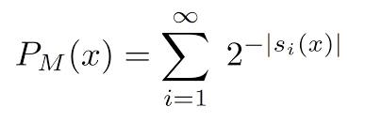
Expected Family Contribution (EFC)
FAFSA
FAFSA on the Web
Mailing a paper FAFSA to the Central Processing System (CPS).
Parent’s & Student’s Income
Allowances Against Parent’s Income
Parent’s & Student’s Assets
Allowances Against Parent’s Assets are part of the calculation
Texas Association of Student Financial Aid Administrators

Slide 6
Which EFC Formula Worksheet should be used?
Formula A
• For dependent students
Formula B
• For independent students without dependents (other than a spouse)
Formula C
• For independent students with dependents (other than a spouse)
Texas Association of Student Financial Aid Administrators

Slide 7
EFC Calculations
There are 3 special EFC Calculations for each Formula (A,B, or C)
Regular Formula: Takes BOTH income & assets into account
Simplified Formula (SF):Takes only income into account, not assets
Auto-Zero EFC: Student’s EFC is automatically zero
Texas Association of Student Financial Aid Administrators

Slide 8
Regular Formula
Full data element formula
• Includes contribution from available income and assets
• Allowances protect portions of income and assets from use for EFC Calculation
• Equal distribution of calculated amount of available family resources among all family members
Texas Association of Student Financial Aid Administrators

Slide 9
Simplified Formula
How does a student qualify for SF?
Must have income (AGI/wages) of $49,999.00 or less
AND (only 1 needed)
Filed a 1040 but did not file a Schedule 1
Filed a tax form from a Trust Territory or
Were not required to file any income tax return
OR
Qualify for a federal means test benefit program
OR
Be a dislocated worker
Texas Association of Student Financial Aid Administrators

Slide 10
Auto-Zero EFC
How does a student qualify for Auto Zero?
Must have income (AGI/wages) of $29,000.00 or less
AND (only 1 needed)
Filed a 1040 but did not file a Schedule 1
Filed a tax form from a Trust Territory or
Were not required to file any income tax return
OR
Qualify for a federal means test benefit program
OR
Be a dislocated worker
Texas Association of Student Financial Aid Administrators

Slide 11
Let’s Test Your Knowledge
SIMPLIFIED
FORMULA?
AUTO-ZERO?
REGULAR?
Texas Association of Student Financial Aid Administrators

Slide 12
Test Your Federal Formula Knowledge
Student is married with a child who they support more than 50% with an AGI of $47,000. They indicated they filled a 1040 and filed a Schedule 1 as well. They did not select a federal means test benefit and selected "no" to being a dislocated worker. – What is the correct formula and calculation?
Regular Calculation/ Formula C
Texas Association of Student Financial Aid Administrators

Slide 13
Test Your Federal Formula Knowledge
The student is dependent and lives with their parents. The parent’s combined AGI is $26,000. The student did indicate on the FAFSA that their family received a means-tested federal benefit during 2021 and 2022 (23/24 FAFSA).
Auto Zero Calculation/ Formula A
Texas Association of Student Financial Aid Administrators

Slide 14
Test Your Federal Formula Knowledge
Student is married without children. Together the couple has a combined AGI of 22,000. They did file an IRS Form 1040 and did not schedule a Schedule 1.
Simplified Formula/ Formula B
*** Remember an independent student without dependents other than a spouse is not eligible for an automatic zero EFC.
Texas Association of Student Financial Aid Administrators

Slide 15
Why calculate an EFC?
• Students/Parents typically do not know how it is determined
• EFC perceived as the “gate keeper” for aid
• Ex: “What is the maximum amount my family can make and still get Pell?”
• Understanding how to calculate helps us explain how all pieces work together
Texas Association of Student Financial Aid Administrators

Slide 16
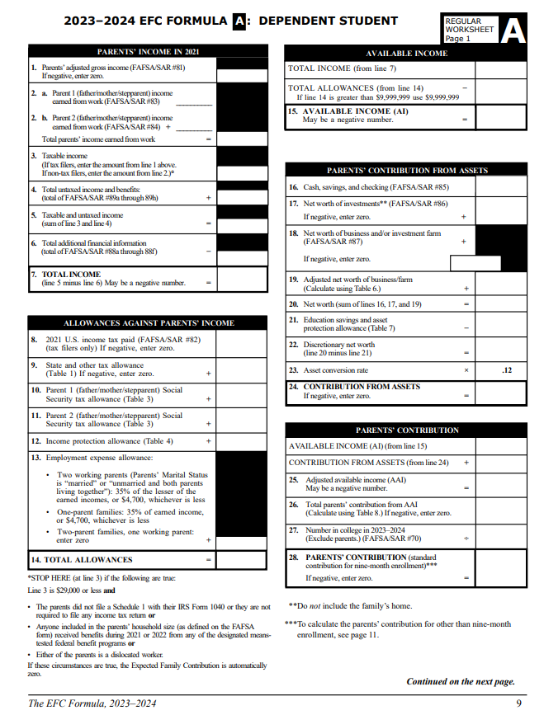
FAFSA Hand Calculation
• Get out your pre-filled FAFSA and your 9 Month EFC Formula Guide for 23-24
• Regular Formula A - Dependent Student
• Two Parts! Student and Parent (Income and Assets)
• Remember! If the note on the sheet says (from line 24) or (Table 3) it’s asking for data from the Formula Guide.
• If the note says (FAFSA/SAR #73) it’s asking for data from the FAFSA.
Texas Association of Student Financial Aid Administrators

Slide 17
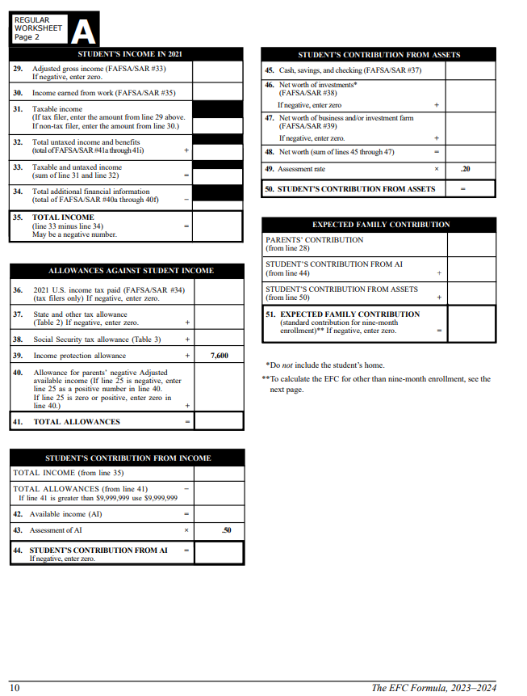
Texas Association of Student Financial Aid Administrators

Slide 18
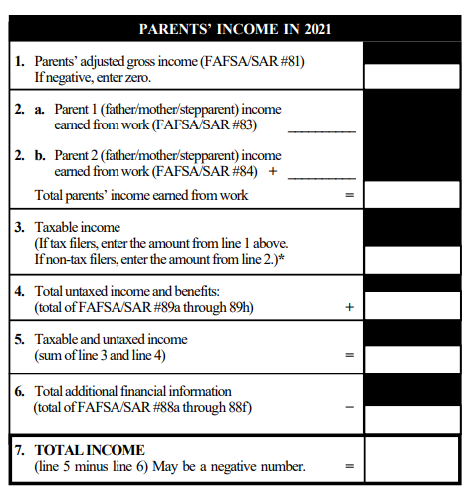
FAFSA Hand Calculation
177,712
Parent’s Income in 2021
• Reference FAFSA and EFC Formula Guide.
• Check your answer on Line 7 before proceeding to Line 8.
39,640
23,942
63,582
177,712
21,000
198,712
0
198,712
Texas Association of Student Financial Aid Administrators

Slide 19
Allowances Against Income
State and Other Tax Allowance
• This allowance aims to reflect estimated non-federal taxes and is calculated based on total income and state of residence. (Calculated on Tables 1 or 2)
Social Security Tax
• This allowance is designed to reflect actual federal payroll taxes (Social Security taxes plus Medicare taxes) and is calculated based on earnings from work. (Calculated on Table 3)
Income Protection Allowance (IPA)
• An allowance which accounts for the family’s basic living expenses. does not consider regional differences in the cost of living and assumes a low standard of living. (Calculated on Tables 4 or 5)
Employment Expense Allowance
• This allowance factors in expenses parents have because they work, such as clothing, meals, and transportation costs.
Texas Association of Student Financial Aid Administrators

Slide 20
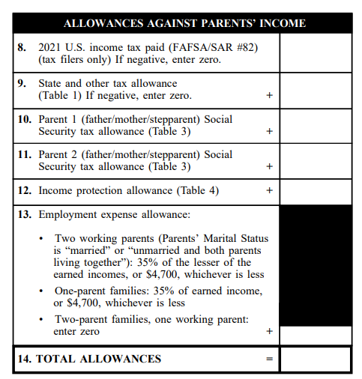
FAFSA Hand Calculation
12,054
Allowances against Parent’s Income 2021
• Reference FAFSA and Tables 1, 3, 4
• Check your answer on Line 14 before proceeding to Line 15.
• Note the Marital Status on the FAFSA for line 13!!!
3,974
3,032
1,832
28,980
4,000
4,700
54,572
Texas Association of Student Financial Aid Administrators

Slide 21
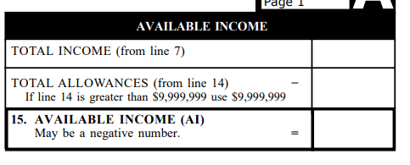
FAFSA Hand Calculation
Parent’s Available Income 2021 (For use in the EFC)
• Reference Formula Guide
• Check your answer on Line 15 before proceeding to Line 16.
198,712
54,572
144,140
Texas Association of Student Financial Aid Administrators

Slide 22
Allowances Against Assets
Education Savings and Asset Protection Allowance
• Designed to protect a portion of the family’s assets for the parents’
retirement, emergencies, and personal educational expenses (Calculated on Table 7)
Asset Conversion Rate
• The asset conversion rate is the amount of the parents’ assets that are assumed to be available to contribute towards the student’s educational costs.
Texas Association of Student Financial Aid Administrators

Slide 23
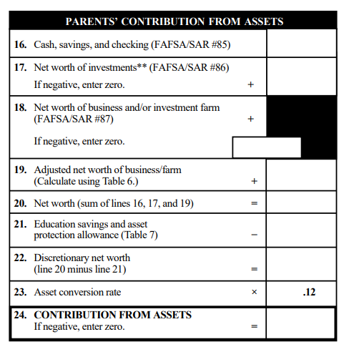
FAFSA Hand Calculation
45,000
902,000
Parent’s Contribution from Assets 2021
• Reference FAFSA, Formula Guide, and Tables 6 & 7
• Check your answer on Line 24 before proceeding to Line 25.
20,000
8,000
955,000
0
955,000
114,600
Texas Association of Student Financial Aid Administrators

Slide 24
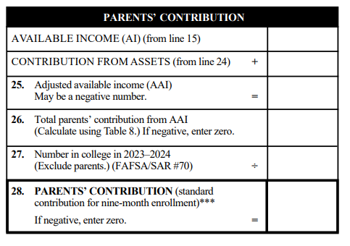
FAFSA Hand Calculation
Parent’s Total Contribution for 2021
• Reference FAFSA, Formula Guide, and Table 8
• Check your answer on Line 28 before proceeding to Line 29.
144,140
114,600
258,740
113,968
2
56,984
1. 258,740 – 38,300 = 220,440
2. 220,440 x 47% = 103,607
3. 103, 607 + 10,361 = 113,968
Texas Association of Student Financial Aid Administrators

Slide 25
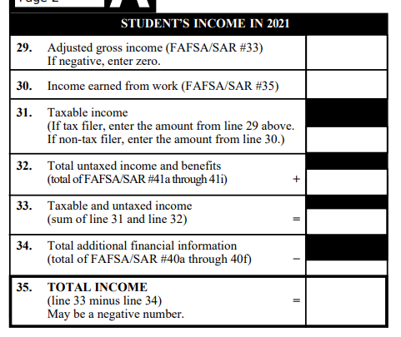
FAFSA Hand Calculation
Student’s Income in 2021
• Reference FAFSA and the Formula Guide.
• Check your answer on Line 35 before proceeding to Line 36.
6,398
6,398
6,398
0
6,398
0
6,398
Texas Association of Student Financial Aid Administrators

Slide 26
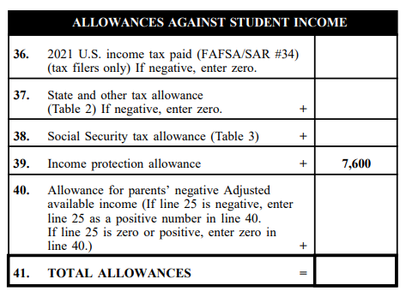
FAFSA Hand Calculation
Allowances Against Student Income in 2021
• Reference FAFSA, Formula Guide, and Tables 2 & 3.
• Check your answer on Line 41 before proceeding to Line 42.
0
64
489
0
8,153
Texas Association of Student Financial Aid Administrators

Slide 27
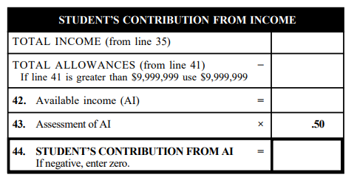
FAFSA Hand Calculation
Student’s Contribution From Income in 2021
• Reference Formula Guide
• Check your answer on Line 44 before proceeding to Line 45.
6,398
8,153
-1,755
0
Texas Association of Student Financial Aid Administrators

Slide 28
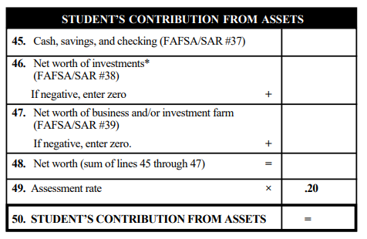
FAFSA Hand Calculation
Student’s Contribution From Assets in 2021
• Reference FAFSA & Formula guide
• Check your answer on Line 50 before proceeding to Line 51.
2,000
0
0
2,000
400
Texas Association of Student Financial Aid Administrators

Slide 29
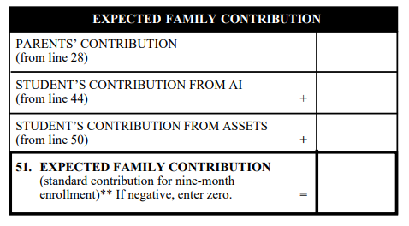
FAFSA Hand Calculation
Expected Family Contribution in 2021
• Reference Formula Guide Pgs. 9-10
56,984
0
400
57,384
Texas Association of Student Financial Aid Administrators

Slide 30
The Future of Need Analysis
• Replacing the Expected Family Contribution (EFC) with the Student Aid Index (SAI)
• -1500 SAI will not allow for packaging over COA
• New Pell Grant methodology relies heavily on poverty guidelines
• Number in college is no longer considered
Texas Association of Student Financial Aid Administrators
Notes:
The FAFSA Simplification Act represents a significant overhaul of federal student aid, including the Free Application for Federal Student Aid (FAFSA®) form, need analysis, and many policies and procedures for schools that participate in the Title IV programs.
The new need analysis formula removes the number of family members in college from the calculation, allows a minimum SAI of -1,500, and implements separate eligibility determination criteria for Federal Pell Grants. However, even though there is a negative SAI, there will still not be any awards over COA so it is still unclear how the negative aspect will play into CoA.

Slide 31
The Future of Need Analysis
• Question regarding housing arrangement (i.e., on campus, off campus, with parent) has been removed.
• Applicants will be asked to provide consent to use new IRS Direct Data Exchange (DDX), which will replace the IRS Data Retrieval Tool (DRT)
• SAI to begin with 24-25 FAFSA Opening December 2023
Draft SAI & Pell Guide
Texas Association of Student Financial Aid Administrators

Slide 32
Final Thoughts
• A myriad of elements go into the EFC! You can’t “guesstimate” what someone’s EFC would be just by asking income information
• Having a strong foundation of how the EFC works will help you know if a professional judgment will help a student and how to best explain to families how the EFC was derived.
Texas Association of Student Financial Aid Administrators

Slide 33
Conclusion
Definition of Need Analysis
• Expected Family Contribution (EFC)
• The 3 Calculations
• The 3 Formulas
• Calculating an EFC
• The Future of Need Analysis
Texas Association of Student Financial Aid Administrators

Slide 34
Resources
• 23-24 FAFSA
• THE EFC FORMULA GUIDE, 2023–2024
• 22-23 NASFAA Credential Study Guide- Need Analysis
• Federal Student Aid: Need Analysis Formulas and Expected Family Contribution
• 2024 – 2025 DRAFT Pell Eligibility and SAI Guide
Texas Association of Student Financial Aid Administrators

Slide 35
Evaluation
Texas Association of Student Financial Aid Administrators

