Slide 1
New Aid Officer Workshop
Cost of Attendance
Andreina Villarreal
San Jacinto College
Texas Association of Student Financial Aid Administrators

Slide 2
What is Cost of Attendance (COA)? Why is it Important? How is COA Determined? Examples Additional Allowances COA Restrictions Professional Judgment Resources
Highlights
Texas Association of Student Financial Aid Administrators

Slide 3
What is Cost of Attendance (COA)
A BUDGET!
Estimates a student’s educational expenses for a period of enrollment.
Determined by Section 472 of Higher Education Act of 1965
Specifies the type of costs that are included.
Institutions determine the appropriate and reasonable amounts for the cost categories.
Texas Association of Student Financial Aid Administrators

Slide 4
Pop Quiz
What is Cost of Attendance ?
A. The exact cost the student needs to pay for a period of enrollment
B. The exact cost the student needs to pay for a total undergrad degree
C. An estimate of a student’s educational expenses for a period of enrollment
D. An estimate of a student’s educational expenses for a total undergrad degree
Texas Association of Student Financial Aid Administrators

Slide 5
Pop Quiz
What is Cost of Attendance ?
C. An estimate of a student’s educational expenses for a period of enrollment
Texas Association of Student Financial Aid Administrators

Slide 6
Pop Quiz
Who determines the appropriate amounts for cost categories?
A. College Board
B. The Institution
C. TASFAA
D. Department of Education
Texas Association of Student Financial Aid Administrators

Slide 7
Pop Quiz
Who determines the appropriate amounts for cost categories?
B. The Institution
Texas Association of Student Financial Aid Administrators

Slide 8
Why is COA Important?
Provides students with expectation of cost for a degree/program
Think about it like this: Its not only how much a car is, but its how much it will take to maintain the car and repairs.
Forms the basis of financial need
Sets a limit on the total aid a student may receive
Formula used to establish a student’s financial need:
Cost of attendance (COA)
- Expected family contribution (EFC)
= Need
Texas Association of Student Financial Aid Administrators

Slide 9
How is COA Determined?
Basic Allowable Costs
Tuition & Fees
Room & Board
Books, supplies, transportation & personal misc. expenses
Student Groups/Category
Hours Enrolled
Program
In-District vs. Out-of-District
Dependent vs. Independent
Average or Actual Cost
Surveys
Local cost research
Published resources
Texas Association of Student Financial Aid Administrators

Slide 10
Pop Quiz
What group/categories can students be divided into?
A. Program of Study
B. Hours Enrolled
C. In-District
D. All of the above
Texas Association of Student Financial Aid Administrators

Slide 11
Pop Quiz
What group/categories can students be divided into?
D. All of the above
Texas Association of Student Financial Aid Administrators

Slide 12
Pop Quiz
List 4 – Allowable costs can be determined by what methods?
Surveys
Local Cost Research
Published Resources
Actual Costs
Texas Association of Student Financial Aid Administrators

Slide 13
Basic Allowable Costs
Texas Association of Student Financial Aid Administrators

Slide 14
Tuition & Fees
set by institution
Amounts normally assessed for students carrying same academic workload as determined by institution
Full Time vs. Half Time vs. ¾ Time vs. LTH Time
May include costs for rental or purchase of equipment, materials or supplies required of all students in the same program of study
Wide range of fees (health insurance, lab fees, graduation fees)
Texas Association of Student Financial Aid Administrators

Slide 15
Room & Board
average or actual
Cost associated with housing and meals
Students living in institutionally owned or operated housing
Student without dependents living at home with parent(s)
Students living off-campus and not with parents
Texas Association of Student Financial Aid Administrators

Slide 16
Books, Supplies, Transportation & Personal Misc. Expenses
Books and Supplies
Actual or estimated amount for the aid period being used
Transportation
Student only and not for the purchase of a vehicle (i.e., public transportation)
Miscellaneous & Personal Expenses
Clothing, toiletries, etc.
Personal computer rental/purchase
Reasonable
Included or case by case
Allowed only once
Calculations can be increased by the Annual cost of living allowances provided by the Coordinating Board.
Texas Association of Student Financial Aid Administrators

Slide 17
Pop Quiz
What are the Basic Allowable Costs?
1. Tuition & Fees
2. Room & Board
3. Books, supplies, transportation & personal misc. expenses
Texas Association of Student Financial Aid Administrators

Slide 18
COA Examples
Community College
University
Private University
Texas Association of Student Financial Aid Administrators

Slide 19
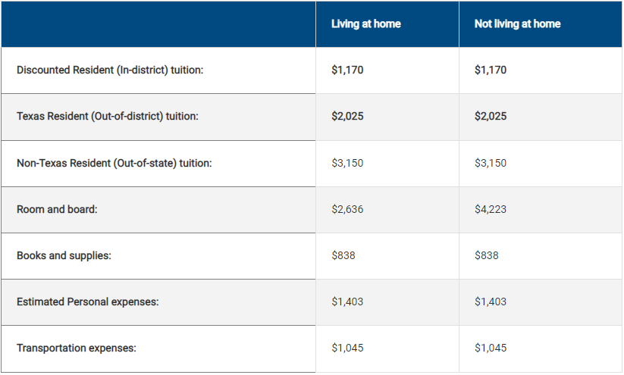
Community College 22-23
Texas Association of Student Financial Aid Administrators

Slide 20
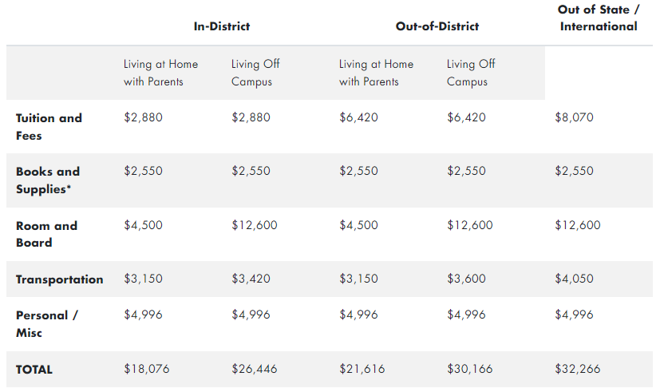
Community College 22-23
Texas Association of Student Financial Aid Administrators

Slide 21
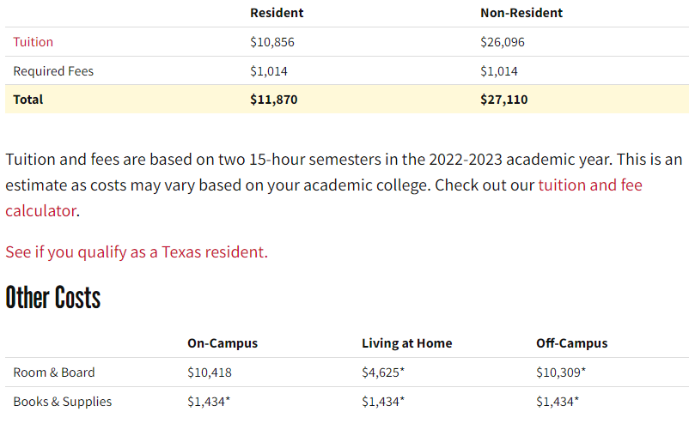
University 22-23
Texas Association of Student Financial Aid Administrators

Slide 22
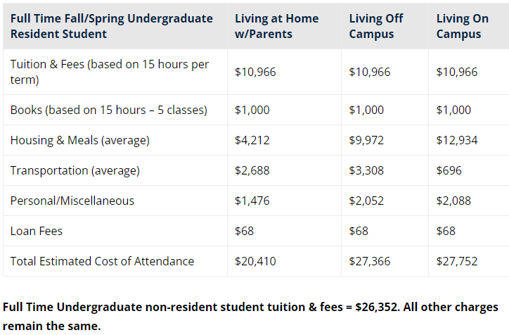
University 22-23
Texas Association of Student Financial Aid Administrators

Slide 23
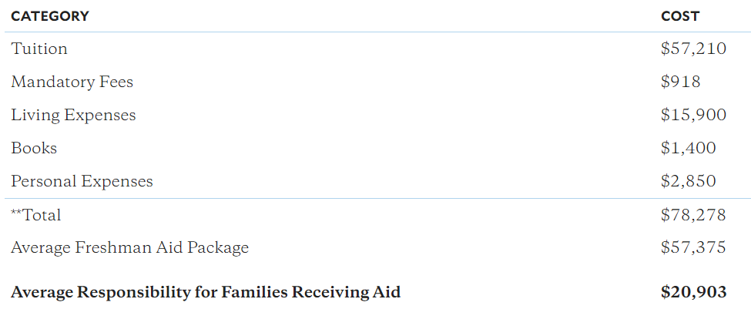
Private University 23-24
Texas Association of Student Financial Aid Administrators

Slide 24
Additional Allowance
Texas Association of Student Financial Aid Administrators

Slide 25
Additional Allowance
Dependent Care
Class time, study time, field work, internship and commuting time for the student
Professional License or Credentials
Must be charged during the period of enrollment, even if taking the exam after the period of enrollment
Study Abroad program
VISA or Passport costs – if approved for credit
Texas Association of Student Financial Aid Administrators

Slide 26
Additional Allowance
Disability Related Expenses
Special services, personal assistance, transportation, equipment, etc.
Cannot be provided by other agencies
Work Experience & Cooperative Education
Reasonable cost associated with such employment
Educational Loan Fees
Actual fees or average of fees charged to borrowers of same loan type
Texas Association of Student Financial Aid Administrators

Slide 27
Pop Quiz
List 5 additional allowances?
Dependent Care
License of Credentials
Study Abroad
Disability
Work Experience/Co-Op
Loan Fees
Texas Association of Student Financial Aid Administrators

Slide 28
COA Restrictions
Certain cost component are excluded for students who are:
Enrolled less than half-time
Room & Board for limited time
Transportation but not personal & misc. expenses
Enrolled in correspondence/online programs
Only includes tuition and fees and may include books and supplies
Can include everything if student is fulfilling period of residential training
Incarcerated
Only includes tuition and fees and books and supplies
Texas Association of Student Financial Aid Administrators

Slide 29
Professional Judgement
COA adjustments are allowed but not required to be offered by the Institution
Must be done on a case-by-case basis
Document, Document, Document
Institutional decisions are final
Be fair!
Texas Association of Student Financial Aid Administrators

Slide 30
Keep In Mind…
Increase in COA does not always result in an increase of aid due to funds having annual limits.
Example:
Cost of Attendance $26,889
Est. Family Contribution - 0
Unmet Need $26,889
Full Package - $23,395
Unmet Need $3,494
Fully Packaged
Pell Grant (FT) $6,895
Loans $10,500
Work-Study + $6,000
Total $23,395
Texas Association of Student Financial Aid Administrators

Slide 31
Keep In Mind…
Students with maximized aid due to annual limits can benefit from a COA increase if they have additional scholarships.
Example:
Cost of Attendance $26,889
Est. Family Contribution - 0
Unmet Need $26,889
Laptop Allowance $1,500
Child Care Allowance $2,000
Transportation + $1,500
Allowance $5,000
NEW COA $29,889
Fully Packaged + Scholarships
Pell Grant (FT) $6,895
Loans $10,500
Work-Study $6,000
Honors Scholarship $4,000
TEOG + $1,500
Total $28,895
Texas Association of Student Financial Aid Administrators

Slide 32
Pop Quiz
Does an increase in COA guarantee an increase of aid?
No
Texas Association of Student Financial Aid Administrators

Slide 33
Resources
https://fsapartners.ed.gov/knowledge-center/fsa-handbook/2022-2023/vol3/ch2-cost-attendance-budget
Texas Association of Student Financial Aid Administrators

Slide 34
Questions
Texas Association of Student Financial Aid Administrators

