Slide 1
FAFSA & Student Eligibility
Melissa Jones
New Aid Officers Workshop
April 19-21, 2023
Great Wolf Lodge
Dallas/Grapevine
Texas Association of Student Financial Aid Administrators

Slide 2
Student Eligibility
File a Free Application for Federal Student Aid (FAFSA)
Meet general and program specific criteria
Prior to processing or disbursing aid
Schools may not impose additional eligibility requirements for Title IV aid not already established in the law or regulations.
Texas Association of Student Financial Aid Administrators

Slide 3
General Eligibility Criteria
US Citizen or Eligible Non-Citizen
Not in default on Title IV loan
Do not owe Title IV Overpayment
Aggregate loan limits not exceeded
Maintain Satisfactory Academic Progress (SAP)
*Drug convictions and Selective Service
Texas Association of Student Financial Aid Administrators
Notes:
* No longer apply - Selective Service still needed for State Aid.

Slide 4
The Big Picture
Submit the FAFSA
>> Application goes through database matches
>> CPS sends the ISIR to the school
>> School completes criteria checks/documentation
>>Financial Aid eligibility determined
Texas Association of Student Financial Aid Administrators

Slide 5
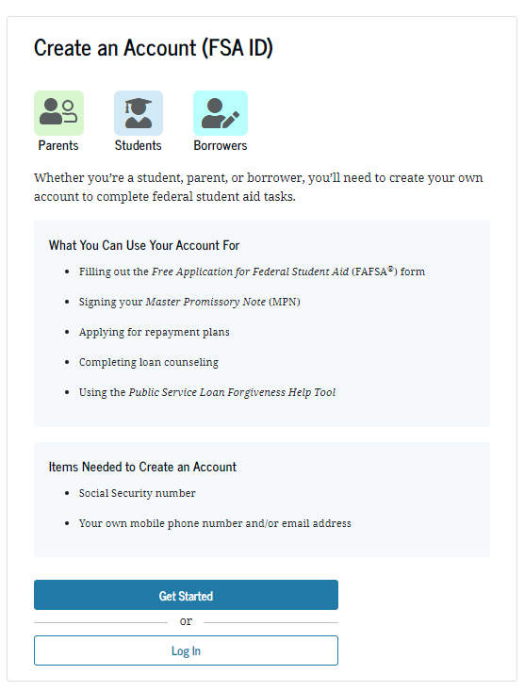
FSA ID
Username/Password to access US Dept of Ed online systems
Legal signature for electronic documents
Parents
Students
Borrowers
www.studentaid.gov
Create Account
Get Started
Texas Association of Student Financial Aid Administrators

Slide 6
Common FSA ID Problems
Forgot Username
Forgot Password
Problem with Student’s SS#
Used Parent’s Email & Student’s SS#
Have you seen any other types of FSA ID problems at your school?
Texas Association of Student Financial Aid Administrators

Slide 7
The Application
Free Application for Federal Student Aid (FAFSA)
Opens each year on October 1^{st*}
Apply through:
FAFSA on the Web
School submits through FAA Access
Paper FAFSA
FAFSA on the phone 1-800-433-3243
What does your school do to promote FAFSA opening?
Texas Association of Student Financial Aid Administrators
Notes:
Does your school promote FAFSA opening day? If so, how?
*Dec for 2024-25 FAFSA

Slide 8
FAFSA on the Web
English or Spanish
Data Retrieval Tool
Skip Logic
Edit Checks
FAFSA Worksheet
Pop up Help
Pop up Chat
Electronic Signatures
Real Time Submission
Online Status Update
Texas Association of Student Financial Aid Administrators

Slide 9
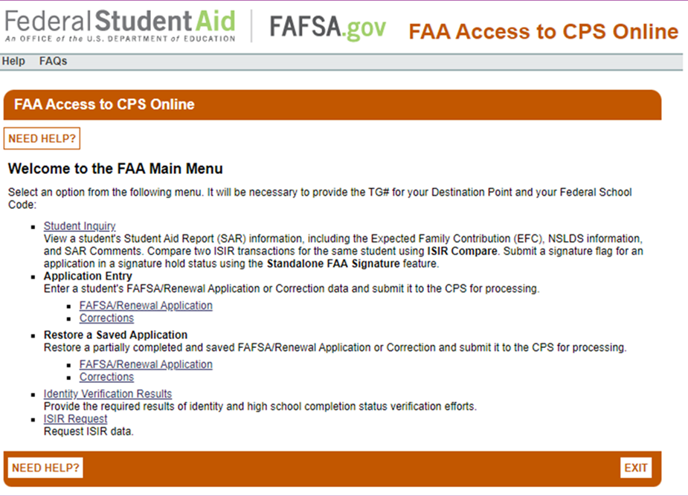
FAA Access to CPS Online
Texas Association of Student Financial Aid Administrators

Slide 10
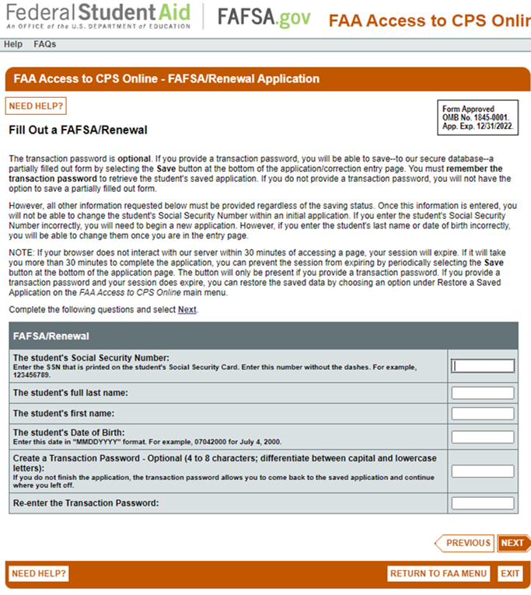
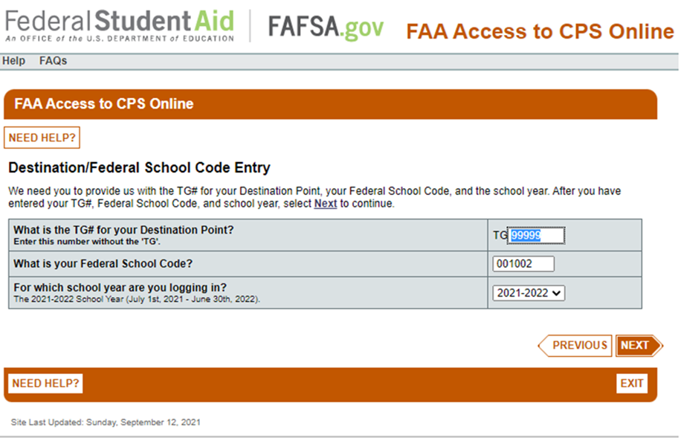
FAA Access Institution Submission
Texas Association of Student Financial Aid Administrators

Slide 11
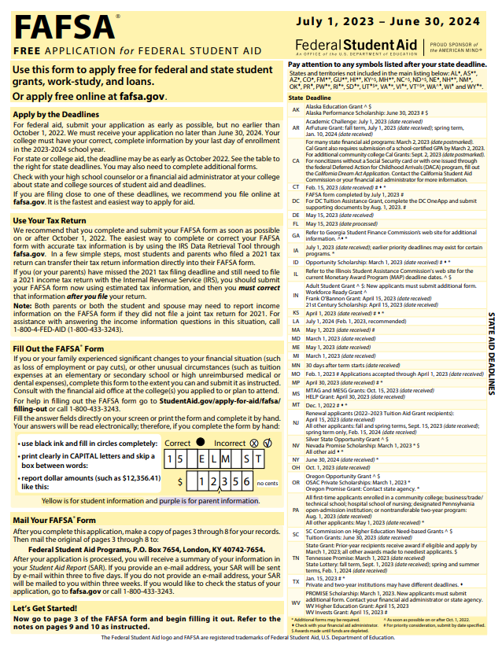
Paper FAFSA
Fillable PDF Form
Great Resource to help answer questions
Similar information as the pop-up help from FAFSA on the Web
FAFSA on the Web pop-up help corresponds to question numbers
Texas Association of Student Financial Aid Administrators

Slide 12
FAFSA by Phone
1-800-FED-AID (1-800-433-3243)
Available:
Monday – Friday 8am to 11pm EST
Saturday – Sunday 11am to 5pm EST
Closed on Federal Holidays
Texas Association of Student Financial Aid Administrators

Slide 13
FAFSA Demo – Test Site
fafsademo.test.ed.gov
Scroll all the way down
Click
Click
Use the FSA IDs and passwords in tables to log in
Fake SSN and student data
Simulation of student experience
2022-2023 and 2023-2024 FAFSA is available to test
Texas Association of Student Financial Aid Administrators

Slide 14
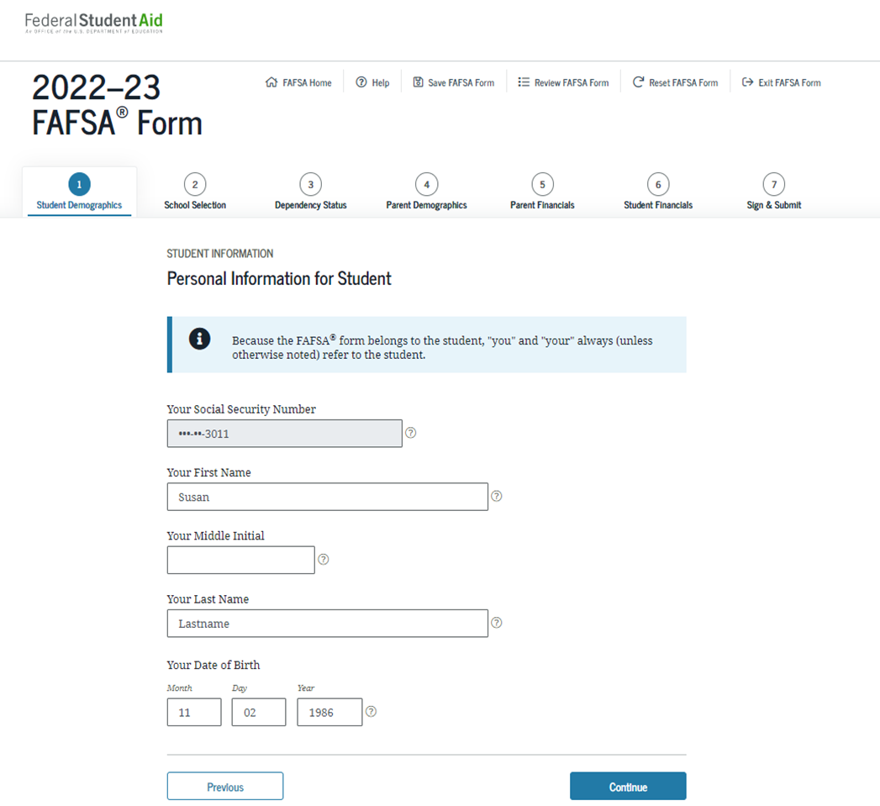
Student Demographic Info
SSN
Date of Birth
Physical Address
Email
State Residency Information
Citizenship Status
High School Completion
Year in College
Work Study*
Parent Education
Texas Association of Student Financial Aid Administrators

Slide 15
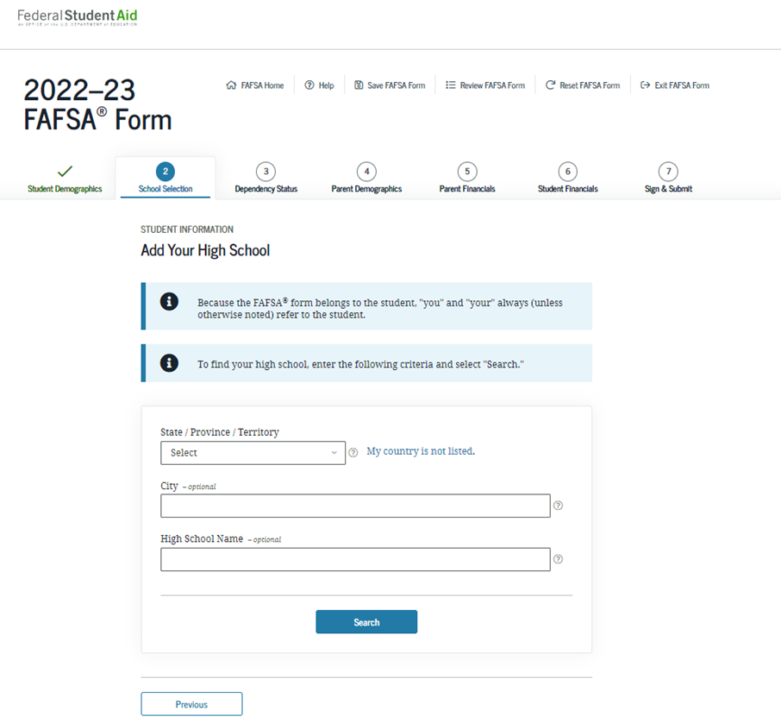
School Selection
High School Name
Search for the Institution to send the FAFSA or Enter 6-digit school code
Student’s Housing Plans
Living on/off campus or with parents
Used to calculate different housing costs for the Cost of Attendance
Texas Association of Student Financial Aid Administrators

Slide 16
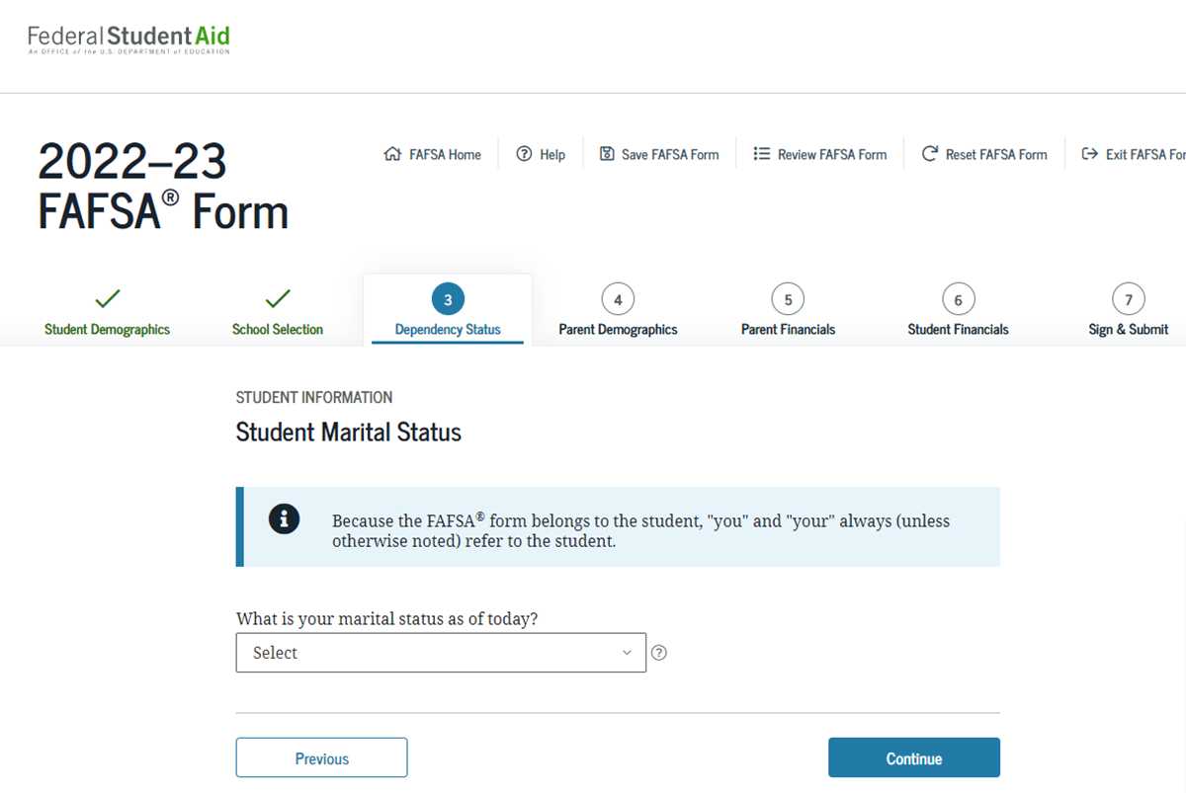
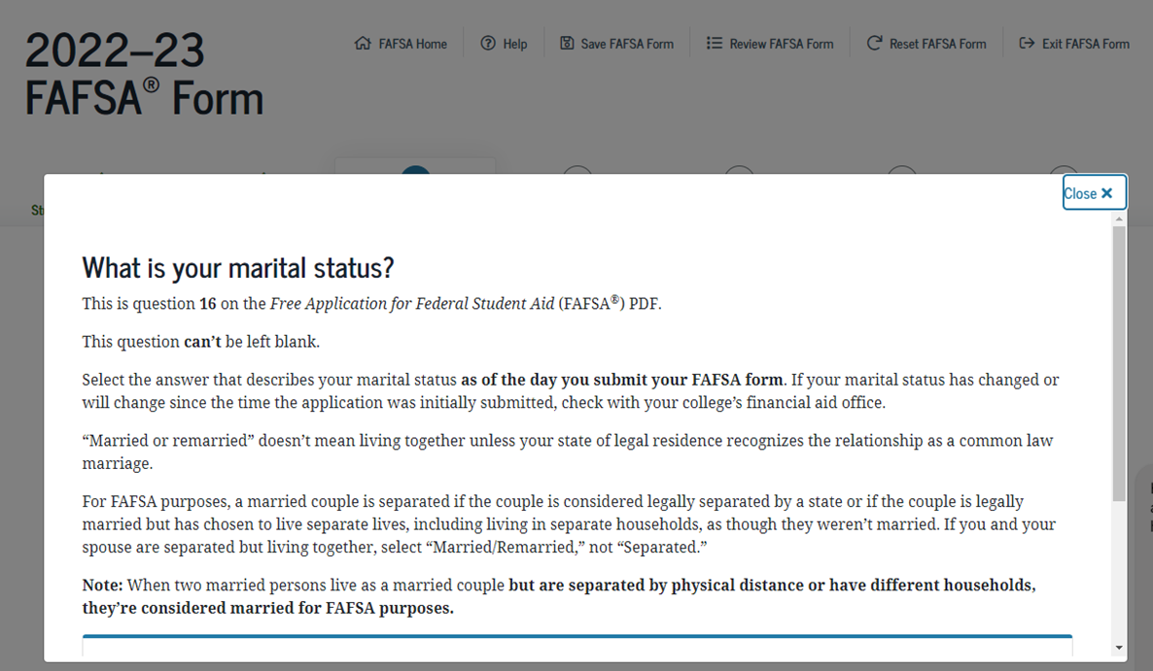
Dependency Status
Texas Association of Student Financial Aid Administrators

Slide 17
Dependent or Independent?
Born before 1/1/1999 | Dependents you Support?
Married | Orphan, Foster Care, Ward of the Court?
Working on Master’s? | Emancipated Minor?
Active Duty? | Legal Guardianship?
Veteran? | Unaccompanied Youth?
Children you Support? | Homeless?
Texas Association of Student Financial Aid Administrators
Notes:
What are some forms of documentation your institution collects to verify independence?

Slide 18
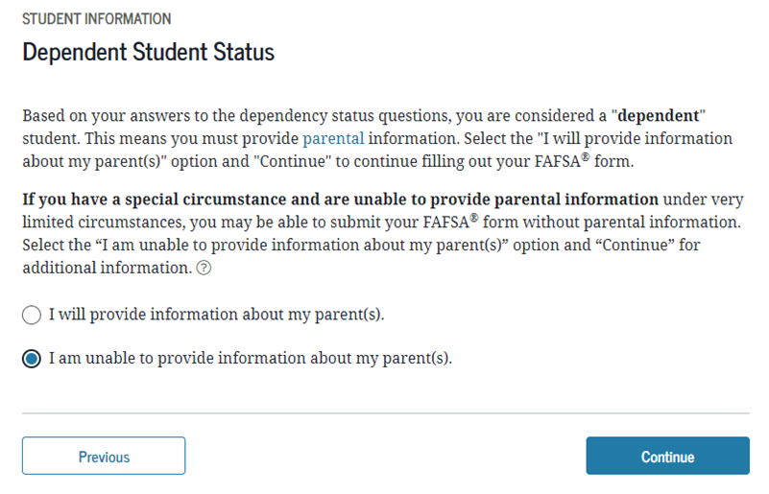
Special Circumstances
Students have the option of skipping the parent questions if they feel they have special circumstances
A list of possible situations
appears on their next page
for them to confirm. They
then work with the institutions
for PJ.
Texas Association of Student Financial Aid Administrators

Slide 19
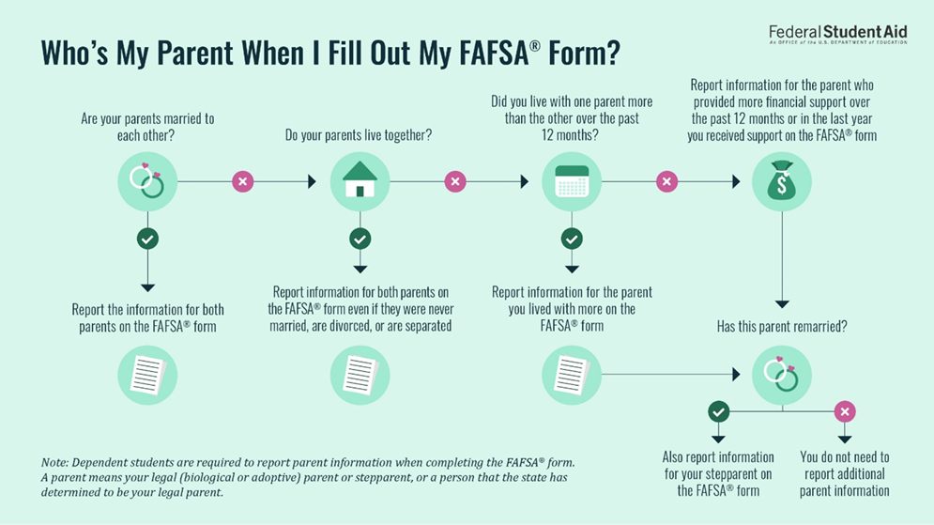
Texas Association of Student Financial Aid Administrators

Slide 20
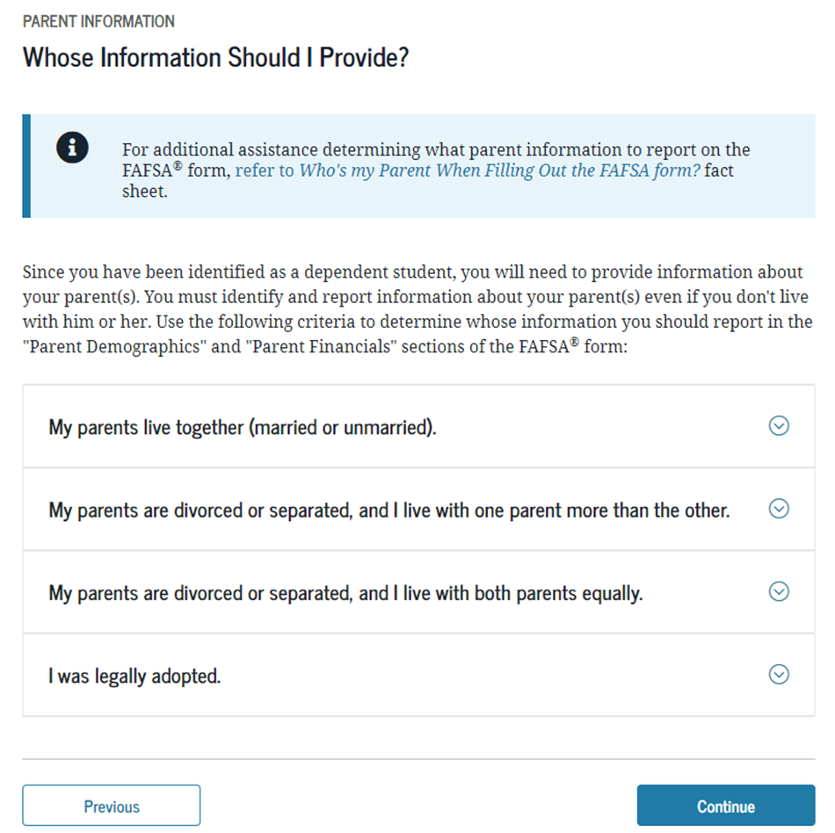
Parent Info on the FAFSA
Name
Date of Birth
SSN
Marital Status
State of Residence
Household Size
Number in College
Texas Association of Student Financial Aid Administrators

Slide 21
IRS Data Retrieval Tool (DRT)*
Pulls IRS tax return data into the FAFSA
Address entered must match the 1040 form
Can be used for the correction process
Relieves the student/parent from submitting
A tax return transcript for verification
Not available for everyone
(ie. amended returns)
Texas Association of Student Financial Aid Administrators
Notes:
This will no longer be active for the 24-25 FAFSA. Students and Parents will sign a consent to link their tax information when completing the FAFSA.

Slide 22
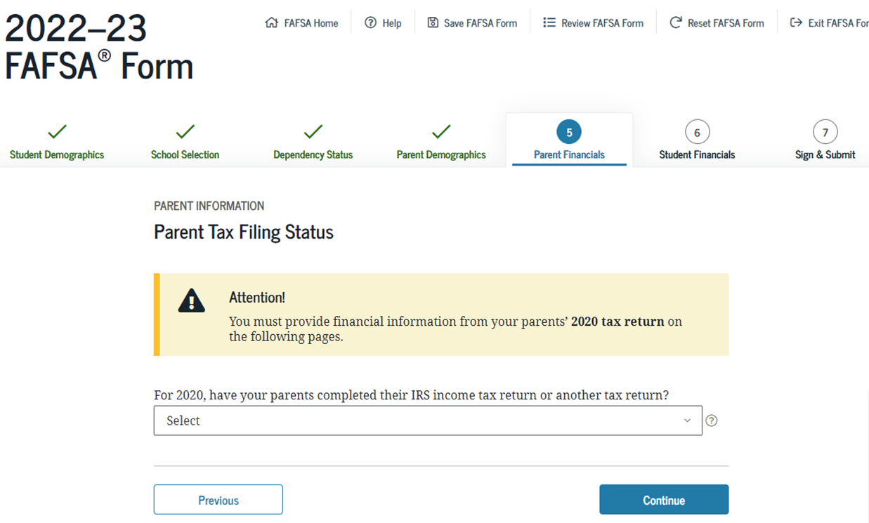
Parent Financial Info
Already filed?
Type of Return (1040, 1040NR, or Puerto Rico…)
Filing Status
IRS DRT Option*
Income from Work
Dislocated Worker
Federal Benefits (SNAP, TANF, etc.)
Income Taxes Paid
Any Untaxed Income
Texas Association of Student Financial Aid Administrators
Notes:
Will File will automatically flag for verification.
*Not an option for 24-25

Slide 23
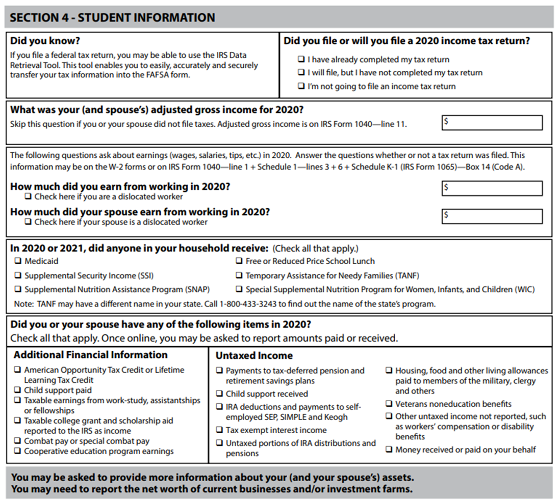
Student Financial Info
Similar to Parent Info
Tax Filing Status
IRS DRT Option
Income from Work
Untaxed Income
Texas Association of Student Financial Aid Administrators

Slide 24
Sign and Submit
Full Summary
Review Disclosures
Student Signs using FSA ID
Parent Signs using FSA ID
Click “Submit My FAFSA Form Now” to complete after signatures
Texas Association of Student Financial Aid Administrators

Slide 25
FAFSA Disclosures
Agree to use aid only for educational purposes | Certify the information is correct | Give ED authority to verify information with other agencies
Agree to provide the school with requested documents | Certify the student’s identity | Acknowledge consequences of false information
Certify not in loan default | Agree to only receive Pell from one institution per enrollment period | Certify student does not owe for a grant overpayment
Texas Association of Student Financial Aid Administrators

Slide 26
Other Ways to Sign
Printed Signature Page:
School submits the signature through FAA Access
and keeps documentation in the student’s file.
Submit Without Signature:
Log back in later to add student/parent signature
Texas Association of Student Financial Aid Administrators

Slide 27
Successfully Submitted
Student receives email confirmation of submission
Student receives 2nd email confirmation that FAFSA was processed
Usually takes 3-5 business days
Provides the Expected Family Contribution (EFC)
Provides Estimated Eligibility Information
Grants
Loans
Notifies student to contact school with questions
Texas Association of Student Financial Aid Administrators

Slide 28
True or False
With limited exceptions, students cannot be required to complete supplemental forms or applications to determine eligibility for Title IV aid.
TRUE
Texas Association of Student Financial Aid Administrators
Notes:
TRUE
Supplemental forms or applications are permitted to provide Title IV funds only when used to collect
additional information required for verifying FAFSA information, confirming intended enrollment status,
or resolving conflicting information pertaining to the applicant.

Slide 29
Financial Aid Administrators may use FSA Access to CPS Online to:
Review the student’s national identification application status with the National Security Agency (NSA).
Submit a signature flag for an application in a signature hold status.
Amend the parent or student IRS tax return
View a student’s SAR information
Continue working on a saved FAFSA or correction
Request ISIR data
Analyze ISIR data as a basis for improving their institutional verification process.
Correct a processed FAFSA
Disburse Title IV Funds
Texas Association of Student Financial Aid Administrators
Notes:
Submit
View
Continue
Request
Analyze
Correct

Slide 30
True or False
If an applicant or parent agrees to transfer data to the FAFSA using the IRS DRT, the applicant or parent will not be able to view the transferred income and tax information on the FAFSA on the Web.
TRUE
Texas Association of Student Financial Aid Administrators
Notes:
True

Slide 31
In which of the following situations would a dependent student report information for two parents?
The student’s legal parents are married.
The student’s legal parents are not married but live together.
The student’s biological parent lives with someone who is not the student’s
legal parent.
The student’s only biological parent has remarried.
Texas Association of Student Financial Aid Administrators

Slide 32
EFC
Expected Family Contribution
An index number used to determine a student’s eligibility for federal student aid
Calculated according to a formula established by law
The same at all schools
Texas Association of Student Financial Aid Administrators

Slide 33
Common FAFSA Mistakes
Missing Signature(s)
Wrong SSN
Wrong Name
Wrong DOB
Parent Income under Student’s Financial Info
Texas Association of Student Financial Aid Administrators

Slide 34
Eligibility Criteria Checks
Checked through the application process
Checked/monitored by the school
Not specifically checked but reviewed if conflicting information exists
Checks throughout the Application Process
Database Matches
Central Processing System (CPS)
Student Aid Report
Institutional Student Information Record (ISIR)
FAFSA Rejects
C-codes or C-flags
Texas Association of Student Financial Aid Administrators

Slide 35
Student submits FAFSA
CPS sends information to federal databases to be reviewed (Database Matches)
Federal databases send match data back to CPS
CPS adds database match results and reject codes to ISIR
CPS sends ISIR to School
Texas Association of Student Financial Aid Administrators

Slide 36
Database Matches
Social Security Administration
Citizenship SSN
Deceased Persons
Department of Homeland Security
Eligible Non-Citizen Status
Alien Registration Number Sent for Match
Primary and Secondary* Confirmation Process
National Student Loan Data System
Verifies Default/Overpayment Status
Reports Unpaid Title IV Fraud
Ensures Annual and Aggregate Limits are not Exceeded
Informs School if Student Subsequently Becomes Ineligible Based on New Data in NSLDS
Identifies Unusual Enrollment History
Texas Association of Student Financial Aid Administrators
Notes:
Secondary confirmation process going away for the 24-25 year.

Slide 37
Removed for 23-24 FAFSA
Department of Defense
Identifies students with a parent or guardian who died as a result of military service in Iraq or Afghanistan after 9/11/2001
Date of Death listed on FAFSA
Possibility for increased Pell eligibility or eligibility for Iraq/Afghanistan Grant
Selective Service System
Registration status of eligible males
Department of Justice (DoJ)
Identifies students with certain drug convictions
For 24-25 FAFSA
Department of Homeland Security
No Longer Perform Secondary Confirmation Process
Texas Association of Student Financial Aid Administrators

Slide 38
CPS Review and Processing
Adds data match results to the FAFSA
Reviews FAFSA data for completion and errors
Adds reject codes and c-codes which identify problems
Sends the ISIR to the School
Usually occurs within 3-5 business days of FAFSA submission
Texas Association of Student Financial Aid Administrators
Notes:
True

Slide 39
Resolving Rejects
Reject reason will be present in FAA information section
Follow instructions for resolution
No EFC will be calculated on rejected ISIRS
Texas Association of Student Financial Aid Administrators
Notes:
In FAA Access to CPS Online

Slide 40
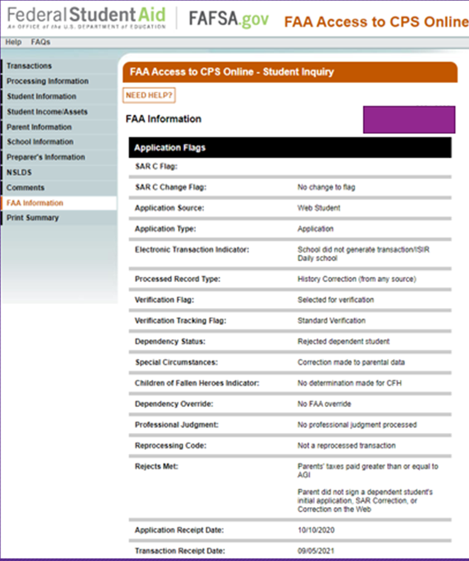
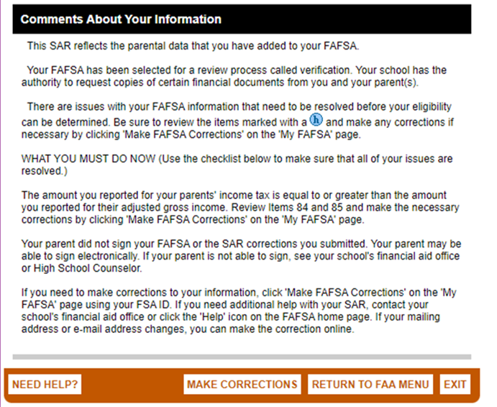
Resolving Rejects
Review student in FAA Access on the FAA information tab
Review the Comments tab
Usually involves correction-documentation required from student
Texas Association of Student Financial Aid Administrators
Notes:
With a show of hands, who here is involved in resolving rejects at your institution?

Slide 41
Resolving Rejects
SAR Comment Codes and Text
Released each Award Year
Review resolution required for codes on FAA Information tab
Texas Association of Student Financial Aid Administrators

Slide 42
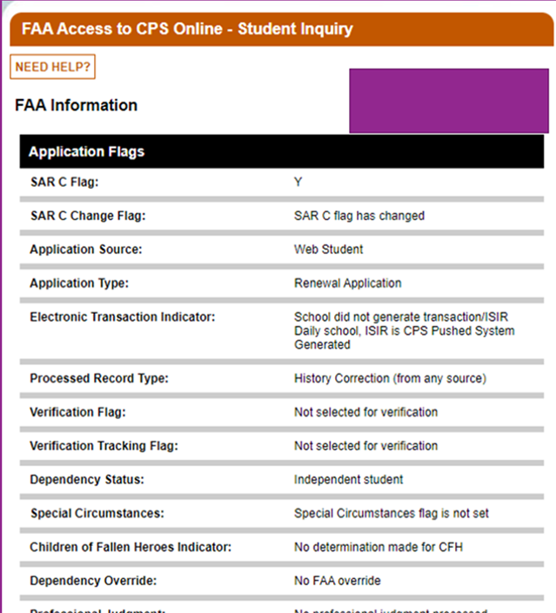
Record is flagged with “C” EFC calculated, but cannot be used Student is ineligible until resolved School collects documentation and submits and corrections
Resolving C-Flags
Texas Association of Student Financial Aid Administrators

Slide 43
Common Resolutions
Mismatches between SSN and DOB
Resolved with Social Security card or student contacts SSA
Invalid citizenship status matches
Resolved with documentation (certificate of naturalization/passport)
Eligibility regained for SSN and citizenship issue for the entire aid year
Texas Association of Student Financial Aid Administrators
Notes:
Secondary confirmation process going away for the 24-25 year.

Slide 44
Criteria Checked and Monitored by the School
Regular student
HS Diploma or equivalent (22-23 changes to
V4/V5. Institution must still validate)
Satisfactory Academic Progress (SAP)
Financial Need
Pell Grant
Iraq and Afghanistan Service Grant
Direct Subsidized Loan
Individual Title IV Program Eligibility Requirements
ie., TEACH Grant
Texas Association of Student Financial Aid Administrators

Slide 45
Criteria Not Specifically Checked
Simultaneous enrollment in elementary or secondary school
Property liens/debt owed to the US
Incarceration
Suspected Fraud
Conflicting information must ALWAYS be resolved.
Texas Association of Student Financial Aid Administrators

Slide 46
Other Eligibility Factors
Prior Degrees
Correspondence Courses, Distance Education, Remedial Coursework
Enrollment Status
Program of Study
Texas Association of Student Financial Aid Administrators

Slide 47
FINANCIAL AID OFFER
How does your institution send award notifications?
Texas Association of Student Financial Aid Administrators
Notes:
Once the Federal Aid Eligibility is determined the school notifies the student.

Slide 48
Questions?
Texas Association of Student Financial Aid Administrators

Slide 49
Resources
Paper FAFSA
FAA Access and FAFSA on the Web Demo
SAR Comment Codes and Text
NASFAA
Today’s News
AskRegs
Webinars
Self-Study Guides
FSA Knowledge Center
FSA Handbook
Application and Verification Guide
Student Eligibility, Chapter 1
This site is your best friend!
TASFAA/SWASFAA Training Opportunities
Dear Colleague Letters
Electronic Announcements
Texas Association of Student Financial Aid Administrators

