Slide 1
New Aid Officer Workshop
Jerica Douglas
Assistant Director
Texas A&M University
Texas Association of Student Financial Aid Administrators

Slide 2
Verification Areas of Focus
Verification Overview
Verification Tracking Groups
Required Documentation
Discretionary Verification
Corrections / Updates / Adjustments
Database Matches
Things to Know
Resources
Texas Association of Student Financial Aid Administrators

Slide 3
Understanding Verification
The process used by the institution to check the accuracy of the information an applicant has provided on the FAFSA
Reduces errors in applicant reported data
Assures applicant receives aid for which they are eligible
If selected for Verification, it must be completed for the applicant to received subsidized student aid
Texas Association of Student Financial Aid Administrators

Slide 4
When Do Corrections Need to be Made?
When the data on the FAFSA conflicts with the documentation, the institution must correct all verifiable data and determine whether corrections must be submitted to the Central Processing System (CPS)
FAFSA data corrections that must be reported to CPS for reprocessing
Changes in a single dollar item of $25 or more
Change in any nondollar item that is required to be verified
Signature requirements on supporting documentation
Texas Association of Student Financial Aid Administrators

Slide 5
Policies and Procedures
Required and should be written
Policy should include:
Time period in which students must submit verification documents and the consequences for failing to submit on time
Requirements as well as areas of flexibility
Procedures used to correct FAFSA data
Methods you use to notify students of a change to the EFC and/or aid amounts
Procedure to refer students to the Office of Inspector General (OIG)
2324 Application and Verification Guide
Texas Association of Student Financial Aid Administrators

Slide 6
When is Verification Required?
When applicants are selected by CPS
When applicants are selected by the institution
Applicants for whom the institution has conflicting information
Texas Association of Student Financial Aid Administrators

Slide 7
Who is Exempt from Verification?
Applicant who is only eligible for unsubsidized aid.
Must verify the identity and Statement of Educational Purpose for V4/V5 categories
Applicant who has been verified by another institution.
Follow your institution’s procedures and policy. Not all institutions will accept another institution’s verified ISIR.
May require a letter confirming verification with transaction number of verified ISIR
Applicant who will not receive Title IV aid.
Information of parent/spouse who is incapacitated or cannot be contacted by normal means.
Texas Association of Student Financial Aid Administrators

Slide 8
Verification Tracking Groups
V1 – Standard Verification Tracking Group
V4 – Custom Verification Tracking Group
V5 – Aggregate Verification Tracking Group
Texas Association of Student Financial Aid Administrators

Slide 9
V1 – Standard Verification Data Points
Tax Filing Status | Required Items to be Verified
Tax Filer | Adjust Gross Income (AGI) U.S. Income Tax Paid Untaxed Portions of IRA Distributions and Pensions IRA Deductions and Payments Tax Exempt Interest Income Education Credits
Non-Tax Filer | Income Earned from Work Confirmation of Non-Tax Filing Status (dependent student exempt)
Tax Filer/Non-Tax Filer | Number of Household Members Number of Household Members in College
Texas Association of Student Financial Aid Administrators
Notes:
Logical Assumptions are exempt: Dep student 2/1 – single parent OR 3/1 – married; Ind student 1/1 – single OR 2/1 – married

Slide 10
Documentation
Tax Filer Documentation
Data Retrieval Tool (DRT) code 02 – Data transferred, unchanged
OR
IRS Tax Return Transcript
OR
Signed IRS 1040 with Schedules 1, 2, and/or 3 if filed
Can accept preparer’s name, address, and PTIN, SSN, or EIN if not signed by tax filer
Less Common Alternatives
Refer to your institutions P&P and/or FSA Handbook
Non Tax-Filer Documentation
Signed statement listing earned income and source if any
W-2s (or the equivalent) from each employer
IRS letter of non-filing – Dated 10/1 of application period or later
Dependent student is exempt
Texas Association of Student Financial Aid Administrators

Slide 11
Household Size
List of household members including names, ages, and relationship to student
Dependent
Student and the student’s parent(s)
Parents’ other children who receive > 50% support from the parent
Parents’ other dependent(s) who live with parents and receive > 50% support from the parent
Independent
Student and spouse (if applicable)
Student’s children who receive > 50% support from the student
Student’s other dependents who live with student and receive > 50% support from the student
Texas Association of Student Financial Aid Administrators

Slide 12
Number in College
List of household members in college at least half-time in a degree/certificate program
Include name of eligible Title IV post-secondary institution
Can include the spouse of independent student
Does not include parent of a dependent student
Does not include dual credit enrollment
Submit statement or Verification worksheet signed by:
Dependent Student – Student and Parent
Independent Student – Student only
Texas Association of Student Financial Aid Administrators

Slide 13
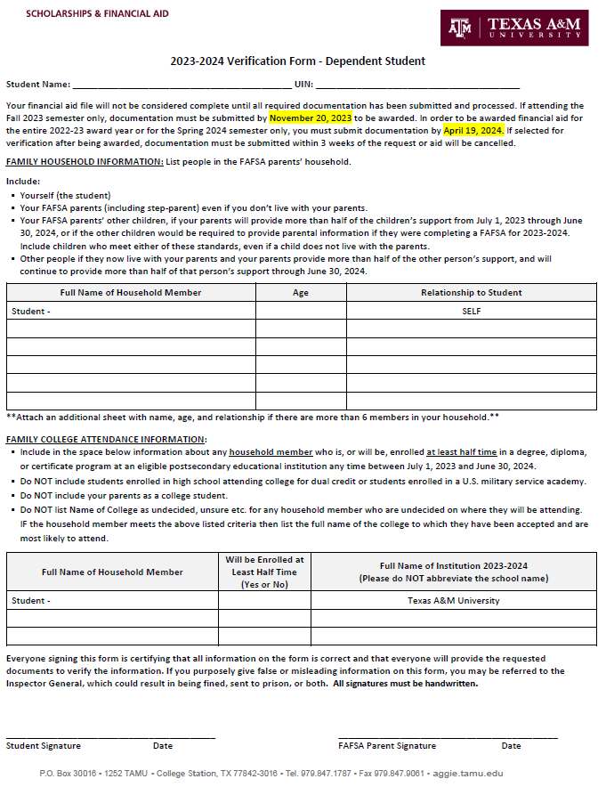
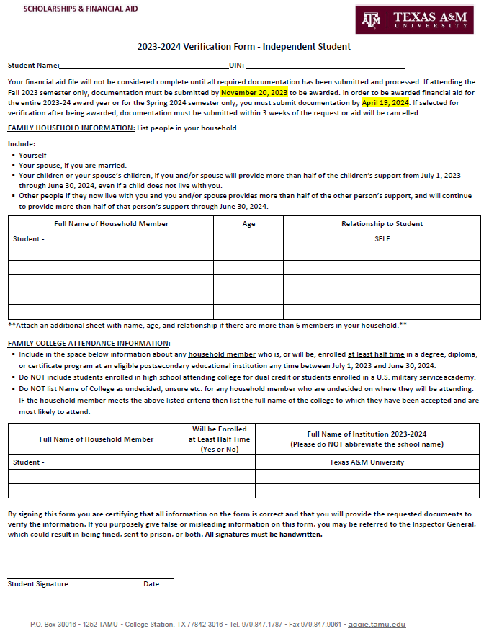
Information to be Verified and Suggested text released every year for your Verification Worksheet. DCL ID: Gen-22-09 Subject: 2023-2024 Award Year: FAFSA Information to be Verified and Acceptable Documentation Published Date: July 8, 2022
Texas Association of Student Financial Aid Administrators

Slide 14
V4 Custom Data Element
Identity and Statement of Educational Purpose (SEP)
Texas Association of Student Financial Aid Administrators

Slide 15
Identity & Statement of Educational Purpose
Identity
Copy of valid, unexpired government issued photo ID
Copy must be annotated with date and reviewer’s name
Student IDs and Military IDs are not acceptable
Statement of Educational Purpose (SEP)
Sign the SEP in the presence of an authorized staff member OR
Sign the SEP in the presence of a Notary
Submit original which includes “wet signature”
Wording on SEP must be exact
Texas Association of Student Financial Aid Administrators

Slide 16
V1+V4=V5
Texas Association of Student Financial Aid Administrators

Slide 17
V5 Aggregate Data Elements
All items and documentation required in the V1 Verification Group
All items and documentation required in the V4 Verification Group
Texas Association of Student Financial Aid Administrators

Slide 18
Discretionary Verification
Dependency Status Questions
Homeless status
Veteran/active-duty status
Orphan, ward, foster care status
Legal guardianship status
Emancipated minor status
Verification of applications for whom a PJ adjustment will be considered – application was not selected for verification by CPS
Applications with comment codes 400/401 and DRT flags 06/07
Texas Association of Student Financial Aid Administrators

Slide 19
Corrections/Updates/Adjustments
Corrections – information was reported incorrectly at the time of application
Updates – information has changed since the time of application
Dependency status changes (except due to marital status)
Number in household and Number in College (except due to marital status) up to the time of verification
Adjustments – information is adjusted based on the institution’s PJ authority
Texas Association of Student Financial Aid Administrators

Slide 20
Database Matches
Social Security Administration – SSA
Department of Homeland Security – DHS
National Student Loan Database System – NSLDS
Department of Defense – DOD
Department of Justice – DOJ
Veteran Affairs
Unsuccessful matches will cause ISIR comment codes (C-Codes) that require action from either the institution or the student which can be associated with the process of verification.
Texas Association of Student Financial Aid Administrators

Slide 21
Customary Support Documentation
Database Match C-Code | Customary Documentation
U.S. Citizenship Status | Birth Certificate (must be born in U.S.) U.S. Passport Certificate of Naturalization Certificate of Citizenship
Eligible Non-Citizenship Status (may require secondary and/or third step verification) | Permanent Resident Card Form I-94/I-94A or Arrival/Departure Record
Social Security Number/Name | Social Security Card
Texas Association of Student Financial Aid Administrators

Slide 22
Things to Know
Alternative supporting documentation
Knowledge of basic tax filing issues
Correct filing status – whether the student/parent are required to file
Amended Returns
Signed copy of 1040x or the IRS Record of Account
IRS Tax Return Transcript, signed 1040 with schedules 1, 2, and/or 3 if filed
Filing Extensions
IRS Verification of Non-filing letter, W-2s, and approved unexpired extension (rare with prior, prior)
Separating information from a joint return
Foreign Returns and/or Income
Auto Zero Calculation
Resolution of DRT Flag 06 & 07
Resolution of SAR Comment Codes 400 & 401
V4/V5 reporting requirements
REFER TO AND FOLLOW YOUR INSTITUTION’S PROCEDURES AND POLICIES!
Texas Association of Student Financial Aid Administrators

Slide 23
Resources
Institutional Policies & Procedures
FSA Handbook
NASFAA – Today’s News, AskRegs, Webinars, Self-Study Guides
TASFAA & SWASFAA Training Opportunities
Colleagues
Texas Association of Student Financial Aid Administrators

Slide 24
Resources
FAFSA Verification IRS Tax Return Transcript Matrix
NASFAA Student Aid Reference Desk
Dear Colleague Letters
Electronic Announcements
Federal Student Aid Knowledge Center
SAR Comment Codes and Text
Student IRS Request Flag

Slide 25
Contact Us
Jerica Douglas
Texas A&M University
jericanicole@tamu.edu
Texas Association of Student Financial Aid Administrators

